Slide 1

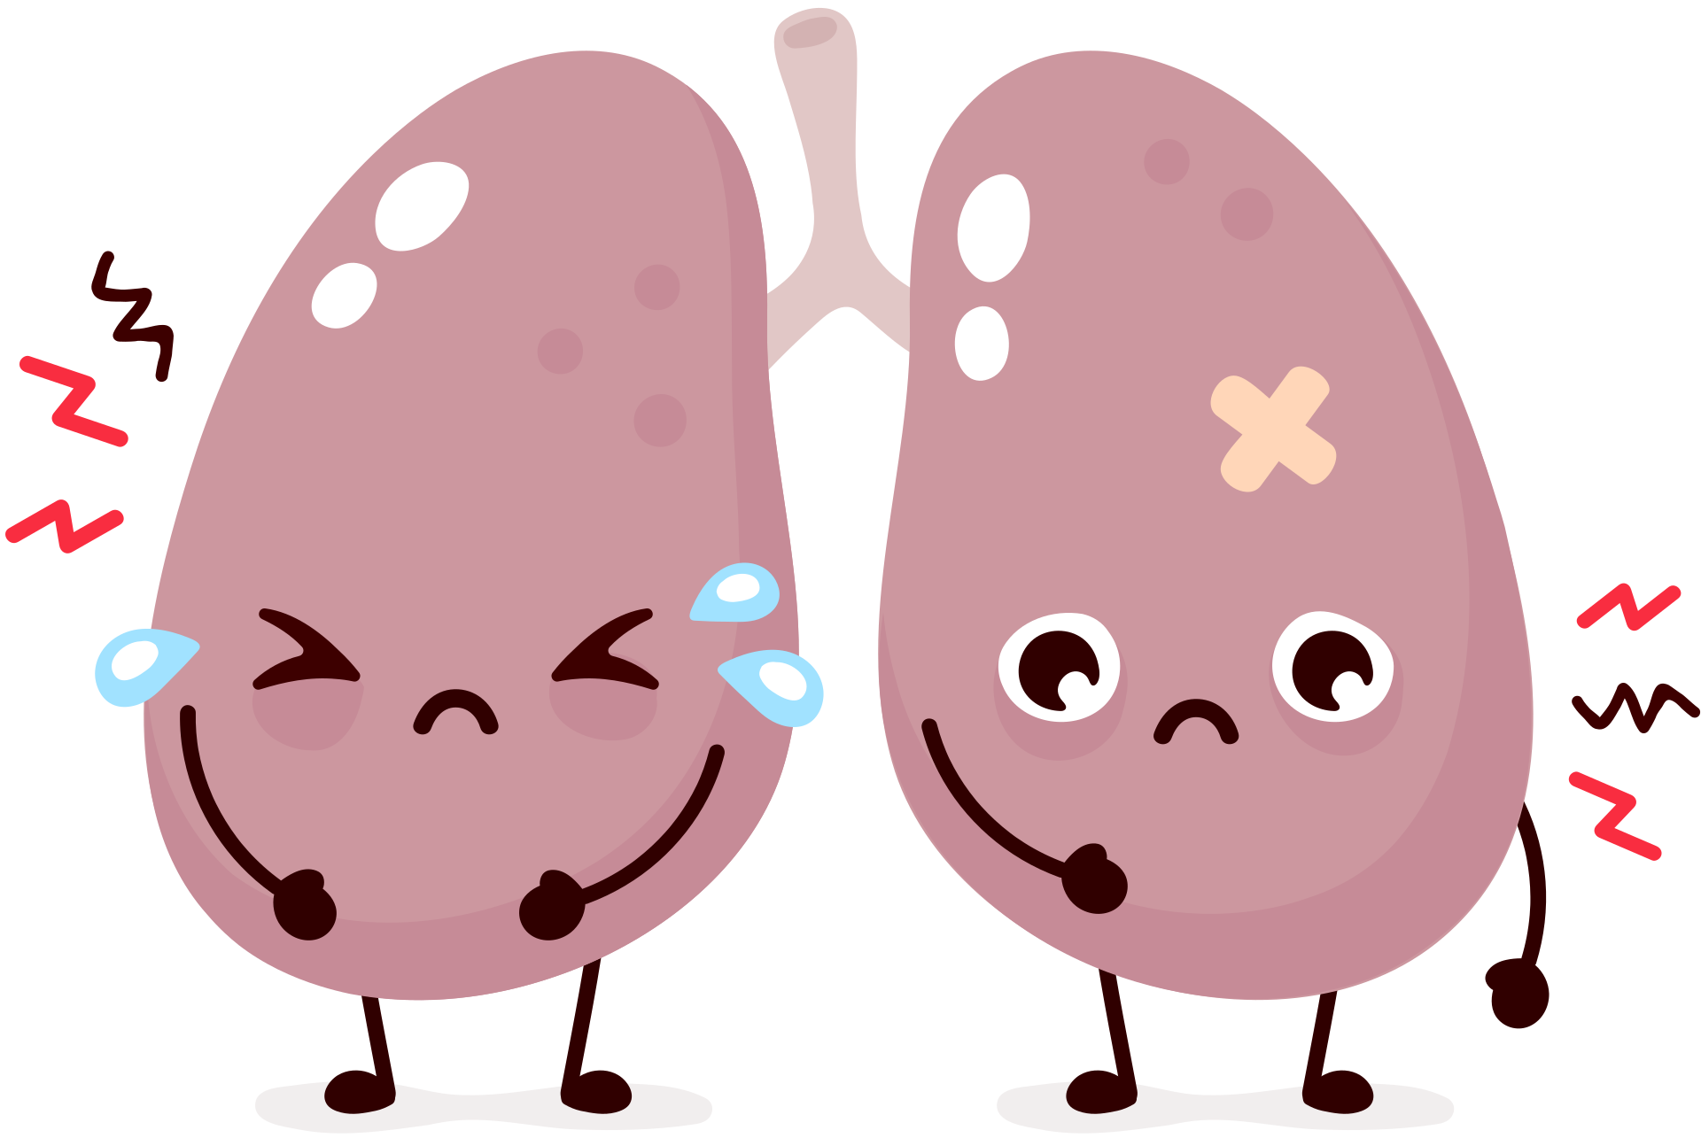
LUNGS ARE FOR LIFE
What smoking or vaping can do to your
lungs and respiratory system
Breathlessness
Coughing
Asthma or worsening asthma symptoms
Sore throat
Narrower airways
Scarring in the lungs
More likely to get sick from infections like a cold or flu
Less endurance and stamina
Lungs are for Life is copyright of the Canadian Lung Association. Reproduction for educational, non-commercial purposes only.

Slide 2
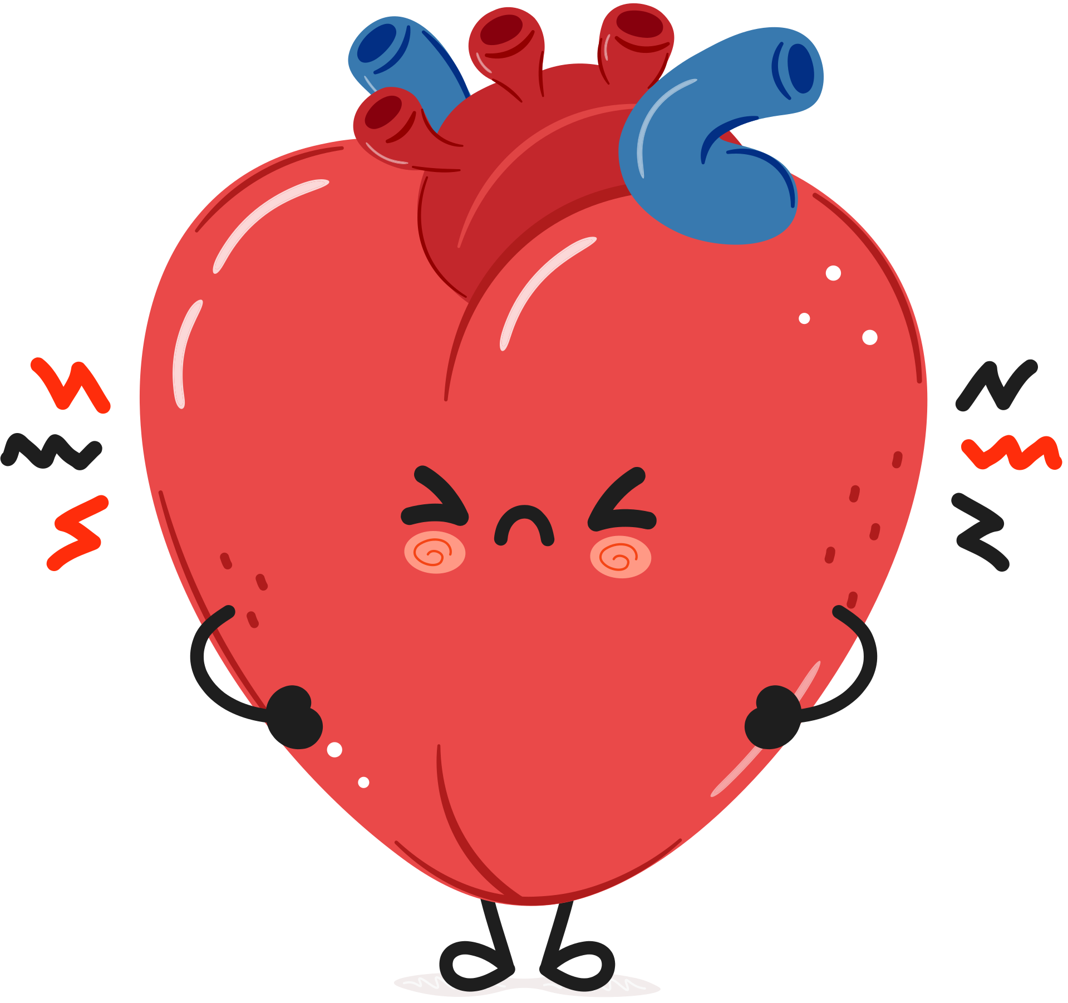
LUNGS ARE FOR LIFE
What smoking or vaping can do to your
heart and circulatory system
Increased blood pressure
Increased risk of heart attack and stroke
Damage to blood vessels
Heart arrhythmias
(when your heart beats faster than normal or skips beats)
Heavy metal build up in blood and organs
Lungs are for Life is copyright of the Canadian Lung Association. Reproduction for educational, non-commercial purposes only.

Slide 3
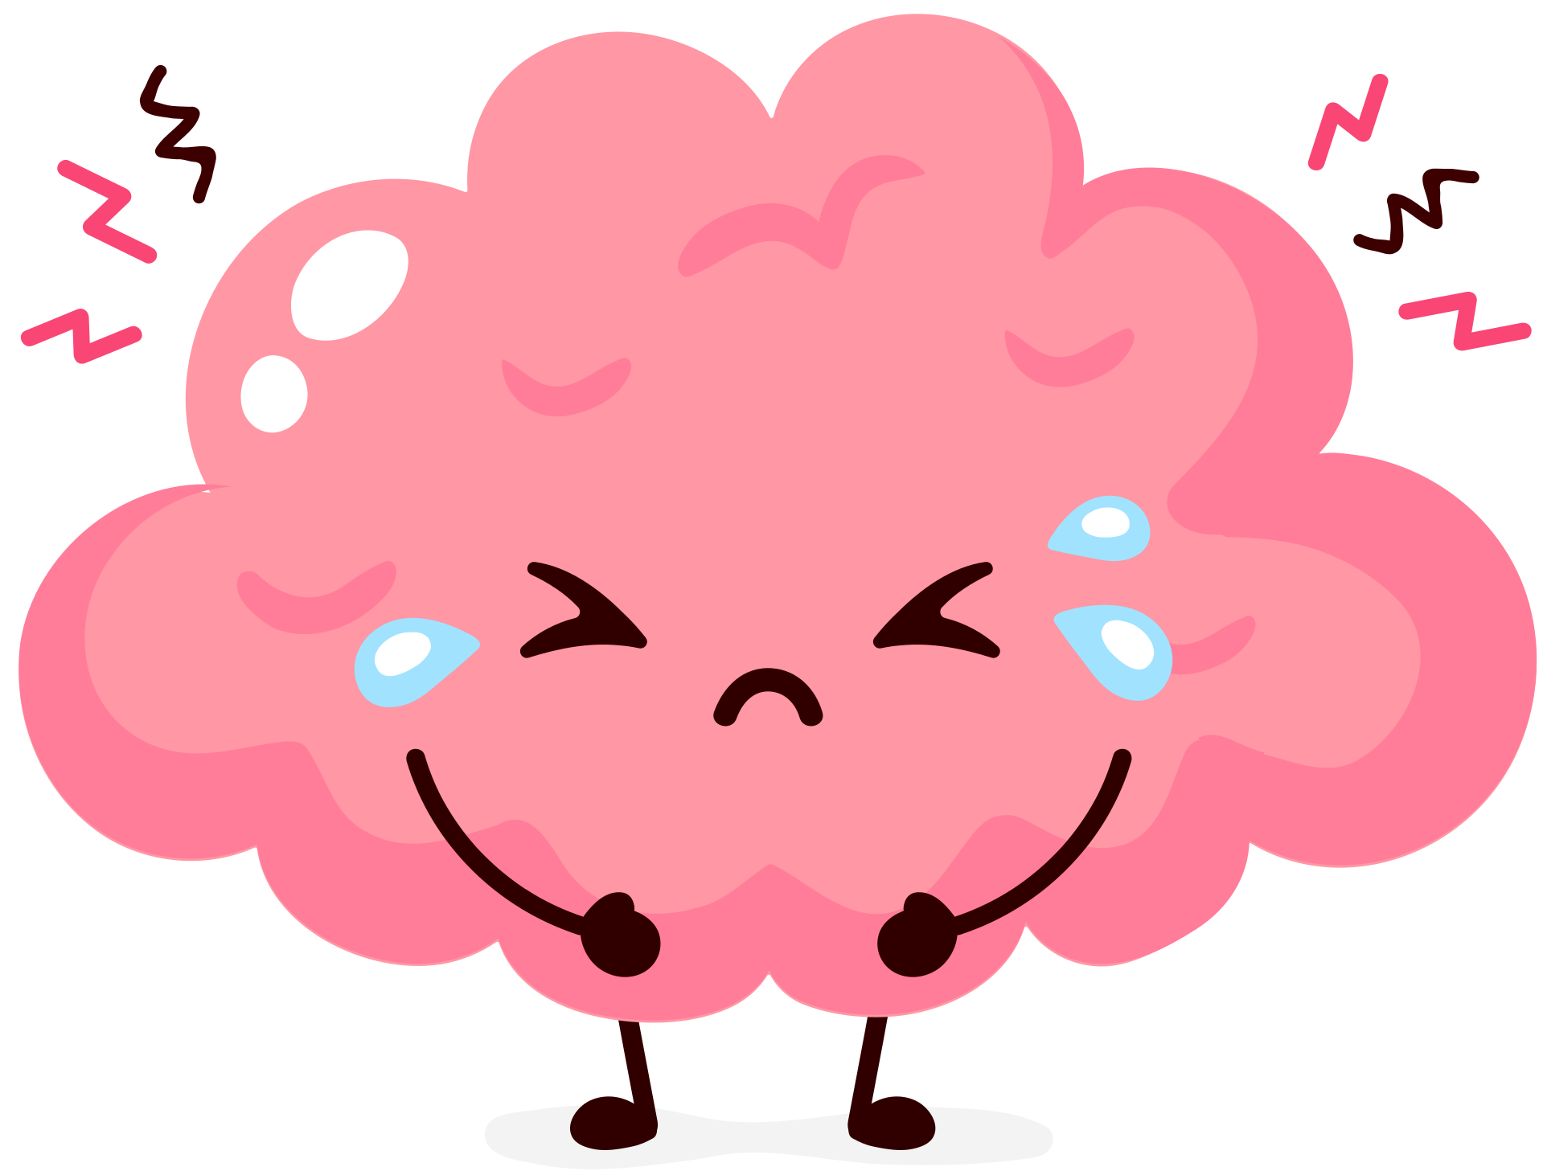
LUNGS ARE FOR LIFE
What smoking or vaping can do to your
brain and nervous system
Problems with memory
Problems with impulsivity
Problems learning and understanding new information
Problems planning ahead and following directions
Lungs are for Life is copyright of the Canadian Lung Association. Reproduction for educational, non-commercial purposes only.

Slide 4

LUNGS ARE FOR LIFE
What smoking or vaping can do to your
teeth and skin
Tooth decay
Clogged pores
Dry mouth
Dry, irritated skin
Black, hairy tongue
Can make acne worse
Gum disease
Lungs are for Life is copyright of the Canadian Lung Association. Reproduction for educational, non-commercial purposes only.

