Slide 1

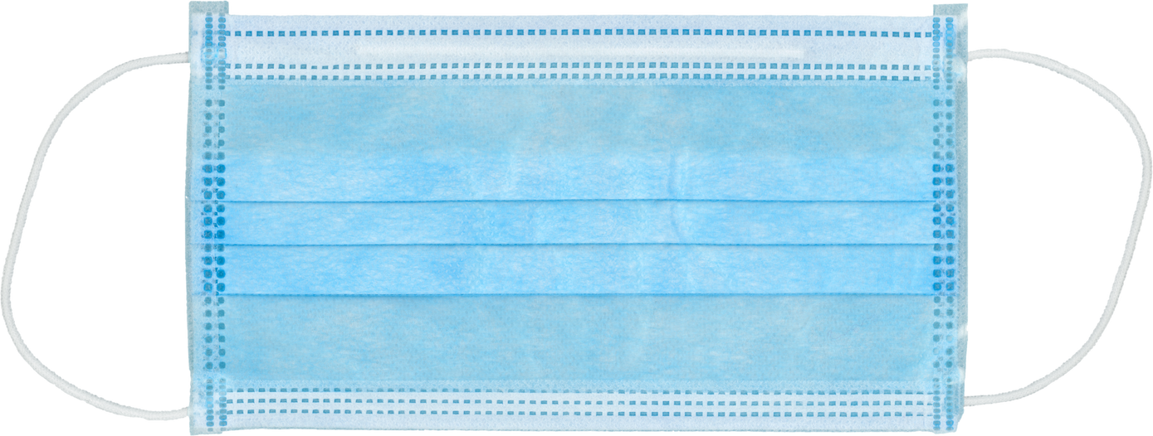

LUNGS ARE FOR LIFE
Huffing and puffing
What is it like to live with COPD?
1.
Put on one of the face masks and hold the piece of paper in front of your face.
Try to move the piece of paper with your breath. Notice how much force is needed.
Put on the second mask over the first. Again try moving the paper with your breath.
2.
2 disposable face masks
1 piece of paper
3.
From the Western University Aging Simulation Lab www.uwo.ca/fhs/agingsim/pdf/Respiratory%20System-Huffing-and-Puffing.pdf Used with permission
Lungs are for Life is copyright of the Canadian Lung Association. Reproduction for educational, non-commercial purposes only.

