Slide 1

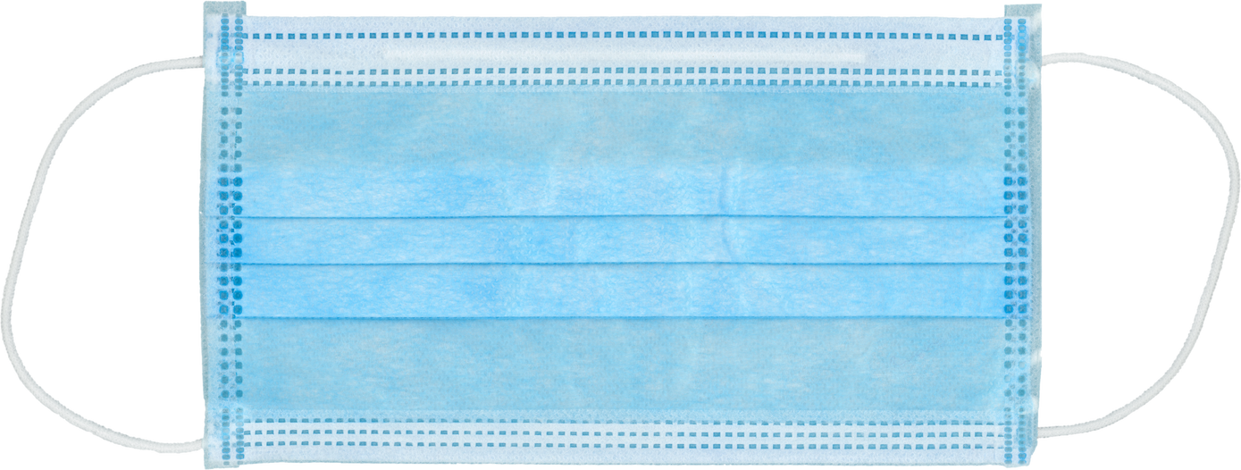

Living with COPD: Huffing and puffing
1.
Put on one of the face masks and hold the piece of paper in front of your face.
Try to move the piece of paper with your breath. Notice how much force is needed.
Put on the second mask over the first.
Again, try moving the paper with your breath.
2.
2 disposable masks
3.
4.
1 sheet of paper
Lungs are for Life is copyright of the Canadian Lung Association. Reproduction for educational, non-commercial purposes only.

