Slide 1
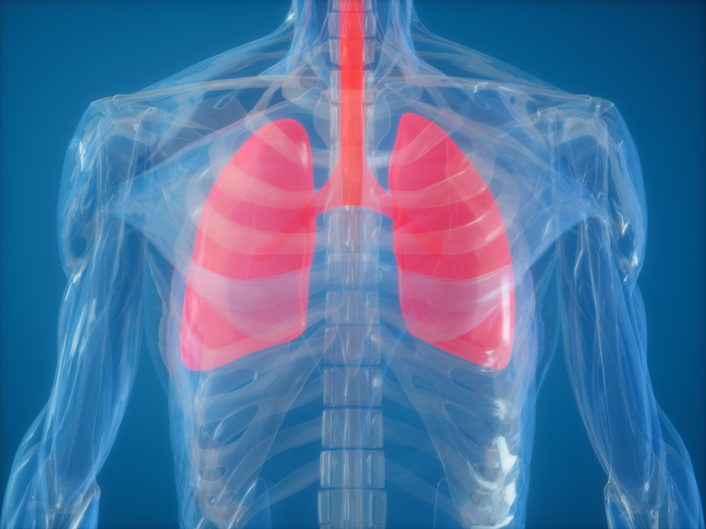

How smoking & vaping harm the body
LUNGS ARE FOR LIFE
Lungs are for Life is copyright of the Canadian Lung Association. Reproduction for educational, non-commercial purposes only.

Slide 2
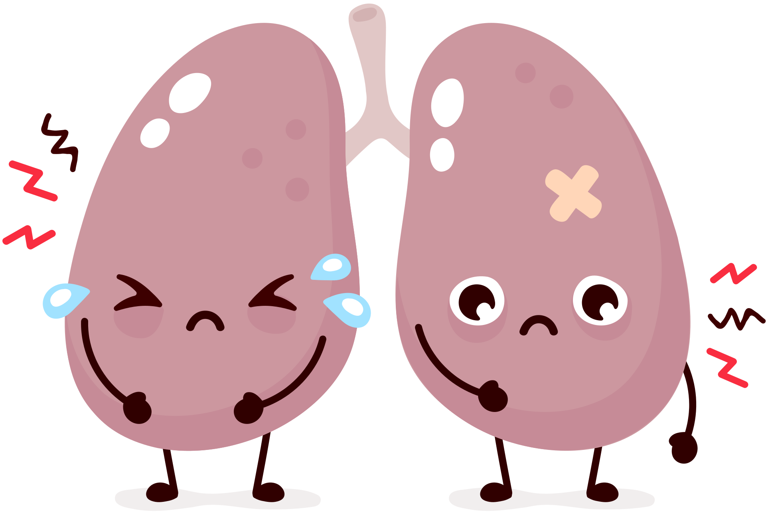
CONSEQUENCES OF SMOKING OR VAPING
LUNGS ARE FOR LIFE
What smoking or vaping can do to your
lungs and respiratory system
  Coughing
  Sore throat
  Breathlessness
  Narrower airways
  Scarring in the lungs
  Less endurance and stamina
  Asthma or worsening asthma symptoms
  More likely to get sick from infections like a cold or flu
Lungs are for Life is copyright of the Canadian Lung Association. Reproduction for educational, non-commercial purposes only.

Slide 3
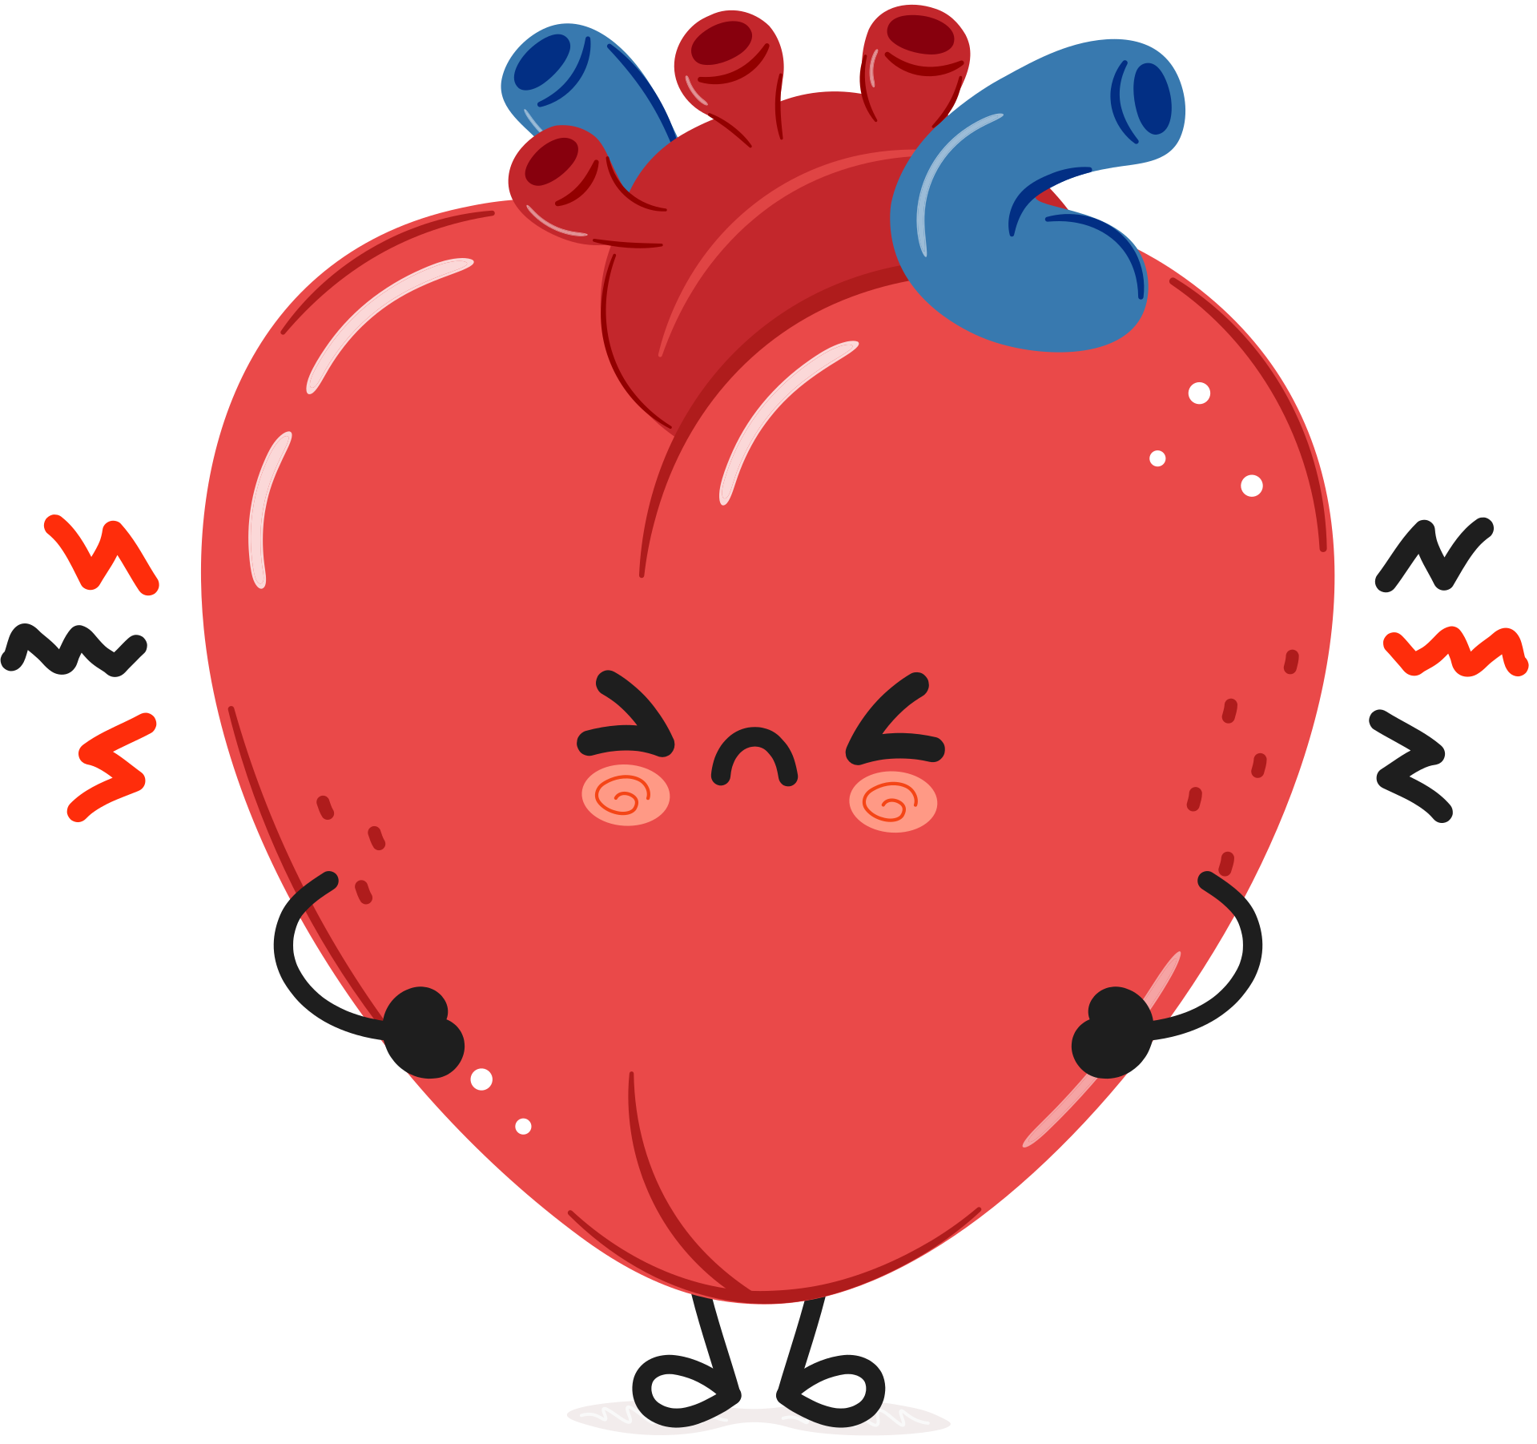
CONSEQUENCES OF SMOKING OR VAPING
LUNGS ARE FOR LIFE
What smoking or vaping can do to your
heart and circulatory system
  Increased blood pressure
  Damage to blood vessels
  Heavy metal build up in blood and organs
  Increased risk of heart attack and stroke
  Heart arrhythmias (when your heart beats faster than normal or skips beats)
Lungs are for Life is copyright of the Canadian Lung Association. Reproduction for educational, non-commercial purposes only.

Slide 4
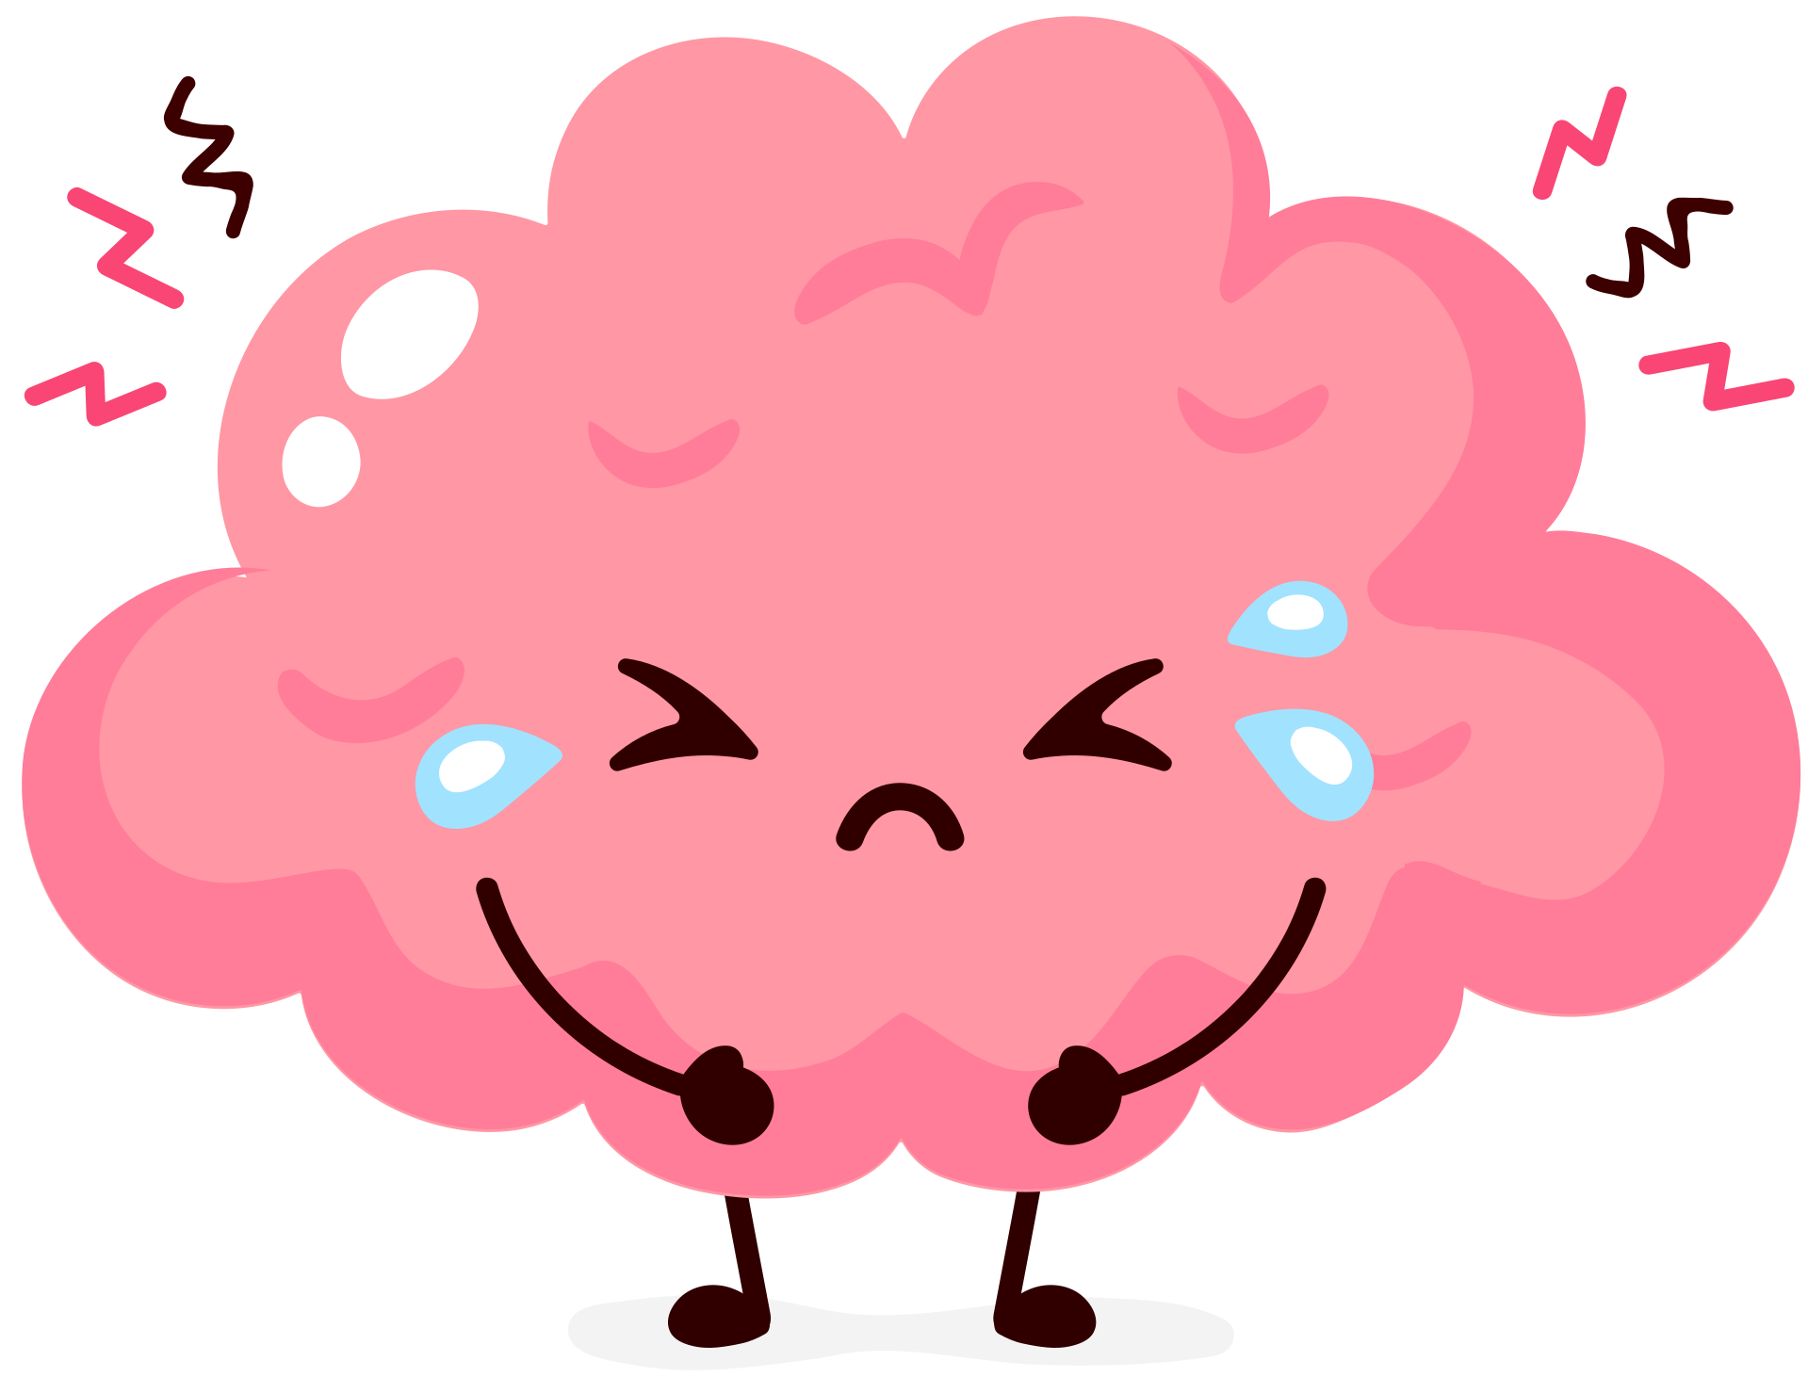
CONSEQUENCES OF SMOKING OR VAPING
LUNGS ARE FOR LIFE
What smoking or vaping can do to your
brain and nervous system
  Problems with memory
  Problems learning and understanding new information
  Problems with impulsivity
  Problems planning ahead and following directions
Lungs are for Life is copyright of the Canadian Lung Association. Reproduction for educational, non-commercial purposes only.

Slide 5

CONSEQUENCES OF SMOKING OR VAPING
LUNGS ARE FOR LIFE
What smoking or vaping can do to your
teeth and skin
  Tooth decay
  Dry mouth
  Black, hairy tongue
  Gum disease
  Clogged pores
  Dry, irritated skin
  Can make acne worse
Lungs are for Life is copyright of the Canadian Lung Association. Reproduction for educational, non-commercial purposes only.

Slide 6

CONSEQUENCES OF SMOKING OR VAPING
LUNGS ARE FOR LIFE
Smoker’s cough
The tar in cigarettes can damage the airways so it’s harder to cough out any mucous (phlegm) in your airways.
People who smoke can have a persistent, phlegmy cough.
The phlegm can also trap bacteria and debris in the airways and can make people who smoke more susceptible to lung infections and lung disease.
Vaper’s cough?
Researchers have discovered that some of the chemicals found in flavouring in vaping devices can also damage the cilia in the airways.
Lungs are for Life is copyright of the Canadian Lung Association. Reproduction for educational, non-commercial purposes only.

Slide 7


Facts about tar
LUNGS ARE FOR LIFE
  Tar is a sticky, brown residue in tobacco smoke containing hundreds of chemicals. Many of these are known to cause cancer.
  The tar in cigarettes is not the same as the tar used on road surfaces or roofing.
  Tar in cigarettes is what stains smokers’ fingers yellow-brown.
  Smoking a pack of cigarettes a day for one year deposits about 1/2 cup of tar in your lungs.
Lungs are for Life is copyright of the Canadian Lung Association. Reproduction for educational, non-commercial purposes only.

Slide 8
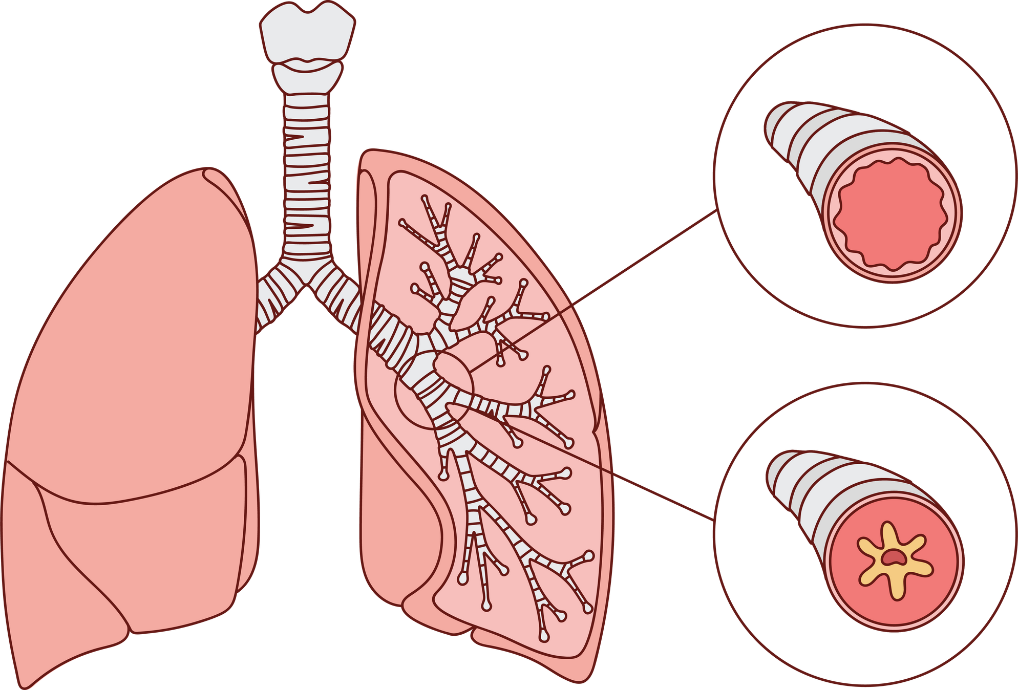
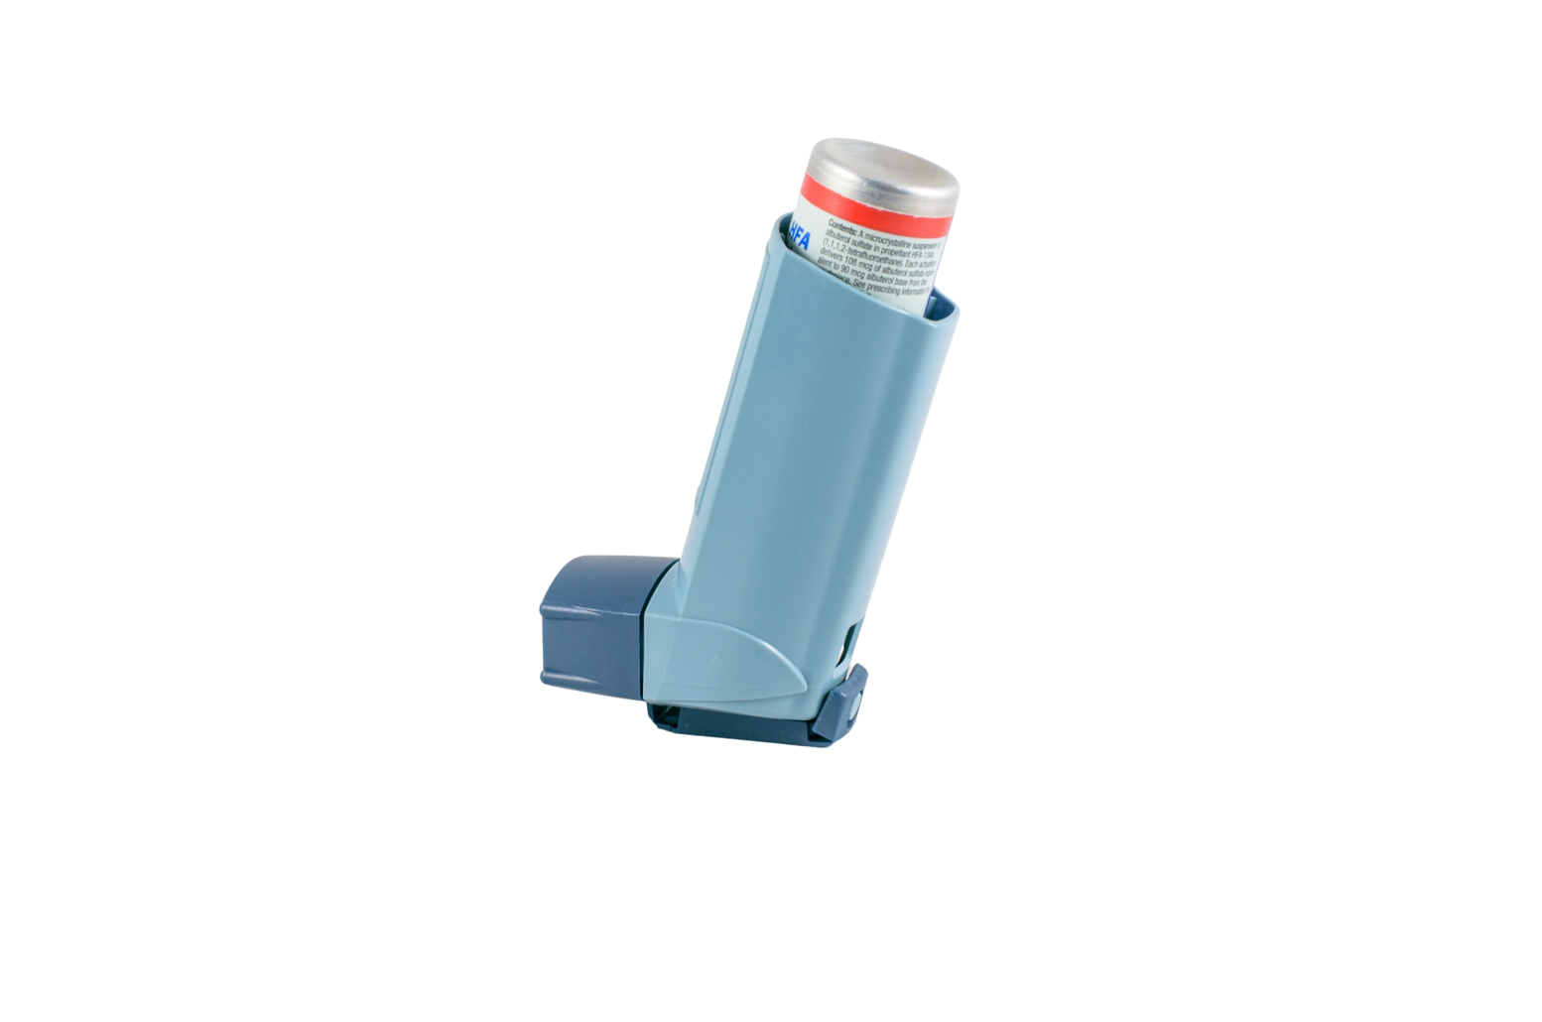

Asthma
Normal airway
Airway of someone with asthma
If someone has asthma, their breathing is fine most of the time. But when they’re around something that triggers their asthma, they can start to have asthma symptoms.
Things like smoke, air pollution, exercise or cold air are common asthma triggers.
Asthma causes the muscles around the airways get tighter and the airways swell and fill with mucous. This makes breathing difficult.
There is no cure for asthma but medication (like inhalers or puffers) can be used to prevent and treat asthma attacks.
The airway swells and fills with mucus
The muscles around the airways tighten
Examples of inhalers (puffers)
LUNGS ARE FOR LIFE
Lungs are for Life is copyright of the Canadian Lung Association. Reproduction for educational, non-commercial purposes only.

Slide 9
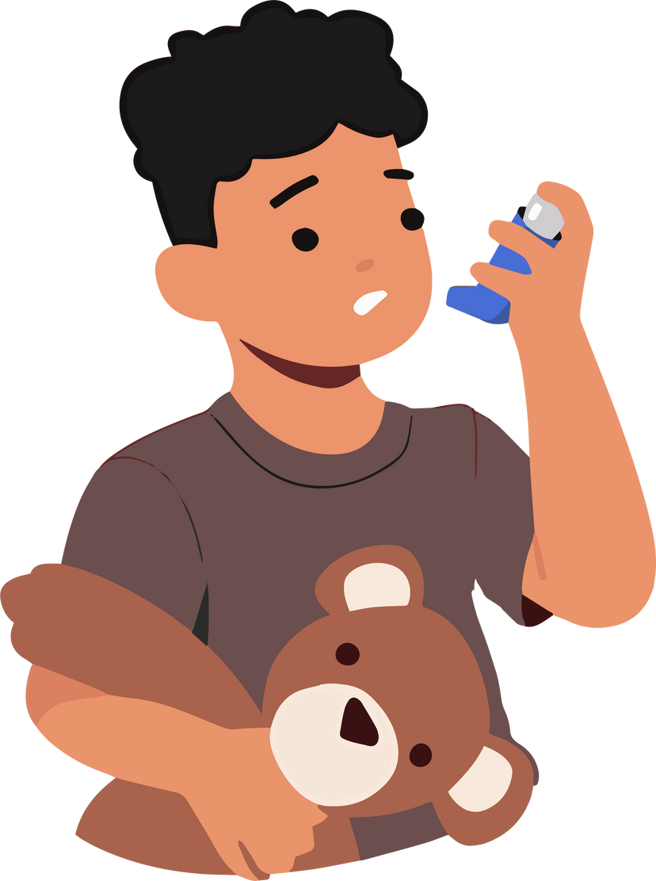
CONSEQUENCES OF SMOKING OR VAPING
LUNGS ARE FOR LIFE
What do smoking and vaping have to do with asthma?
  Asthma is more common in children who grow up around people who smoke.
  People who smoke or vape can experience asthma-like symptoms.
  If you have asthma, smoking and vaping can make the symptoms worse.
  Being near someone who’s smoking or vaping can trigger an asthma attack.

Slide 10
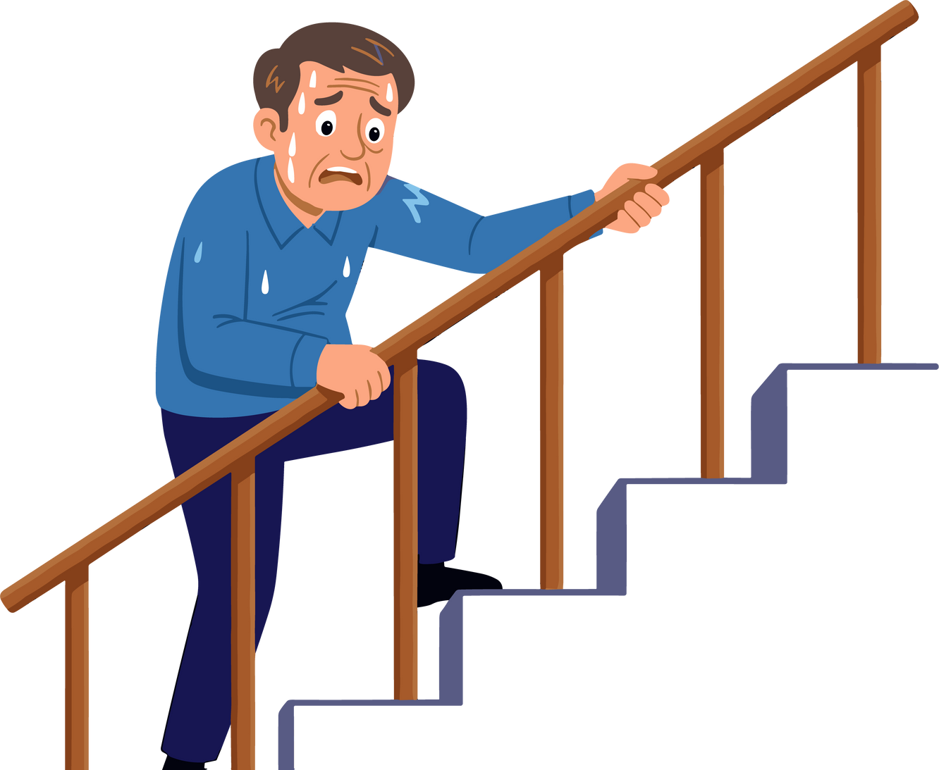
CONSEQUENCES OF SMOKING OR VAPING
LUNGS ARE FOR LIFE
Chronic obstructive pulmonary disorder (COPD)
  Makes breathing very difficult
  Causes the airways become swollen and fill with mucus
  Air sacs (alveoli) also break down, trapping air in the lungs
  About 70% of people with COPD have a history of smoking
Someone with COPD may not realize that they are becoming more short of breath until it becomes very hard to do simple tasks like walking up stairs. Sometimes people think being short of breath is just “getting old”.
Lungs are for Life is copyright of the Canadian Lung Association. Reproduction for educational, non-commercial purposes only.

Slide 11
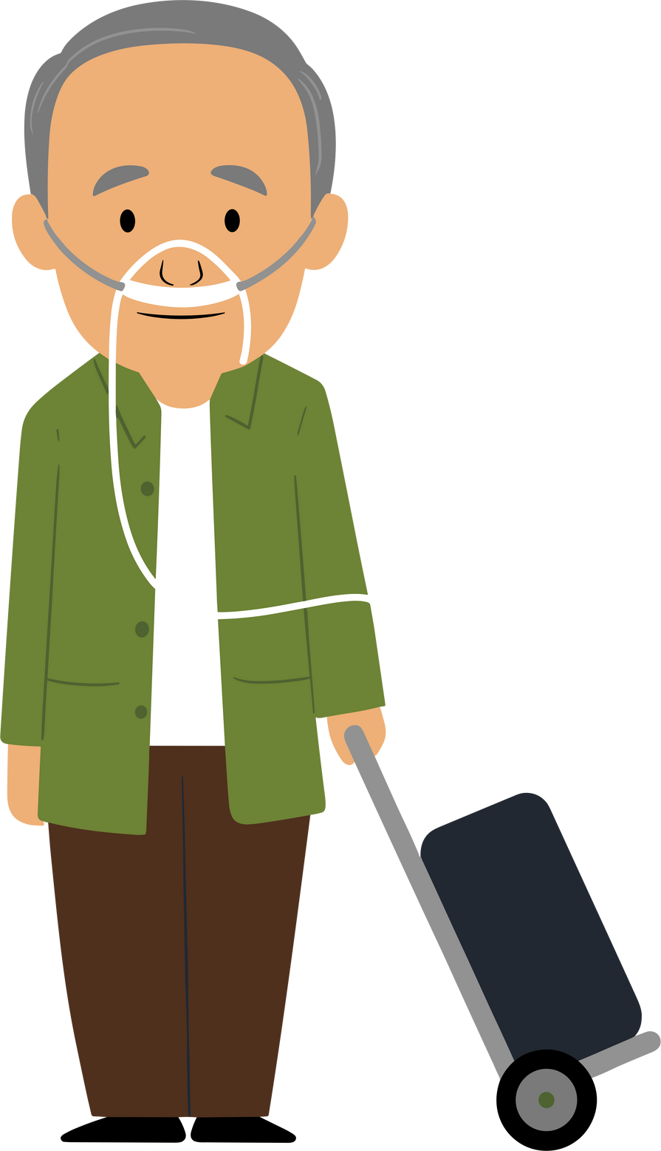
CONSEQUENCES OF SMOKING OR VAPING
LUNGS ARE FOR LIFE
Chronic obstructive pulmonary disorder (COPD)
Some people with COPD need to use oxygen tanks to get enough oxygen into their blood because their lungs are so damaged.
There is no cure for COPD. It can be treated with inhalers and other medicine but it will get worse over time and can be fatal.
Exercising and staying active can slow down COPD.
Lungs are for Life is copyright of the Canadian Lung Association. Reproduction for educational, non-commercial purposes only.

Slide 12
CONSEQUENCES OF SMOKING OR VAPING
LUNGS ARE FOR LIFE
Lung cancer
  Smoking is the #1 risk factor for lung cancer
  About 70% of lung cancer in Canada is caused by smoking
  Lung cancer kills more Canadians than any other type of cancer
  Most people don’t know the symptoms of lung cancer and don’t go to the doctor until the cancer has spread
  New treatments, technologies and medicines mean people are living longer, especially if lung cancer diagnosed early!
Lungs are for Life is copyright of the Canadian Lung Association. Reproduction for educational, non-commercial purposes only.

Slide 13
Facts about tar
  Tar is a sticky, brown residue in tobacco smoke containing hundreds of chemicals. Many of these are known to cause cancer.
  Tar in cigarettes is what stains smokers’ fingers yellow-brown.
  The tar in cigarettes is not the same as the tar used on road surfaces or roofing
  Smoking cigarettes with lower tar does not always reduce the risk of lung cancer.
  Smoking a pack of cigarettes a day for one year deposits about 1/2 cup of tar in your lungs.
LUNGS ARE FOR LIFE
Lungs are for Life is copyright of the Canadian Lung Association. Reproduction for educational, non-commercial purposes only.

Slide 14
Symptoms of lung cancer
LUNGS ARE FOR LIFE
If someone you love is having symptoms of lung cancer, encourage them to talk to their doctor.
  A cough that doesn't go away and gets worse over time
  Chest pain that doesn't go away
  Coughing up blood
  Feeling short of breath
  Wheezing
  Losing your voice
  Frequent episodes of pneumonia and/or bronchitis
  Swollen neck and face
  Not hungry, losing weight without trying
  Feeling tired
Lungs are for Life is copyright of the Canadian Lung Association. Reproduction for educational, non-commercial purposes only.

Slide 15
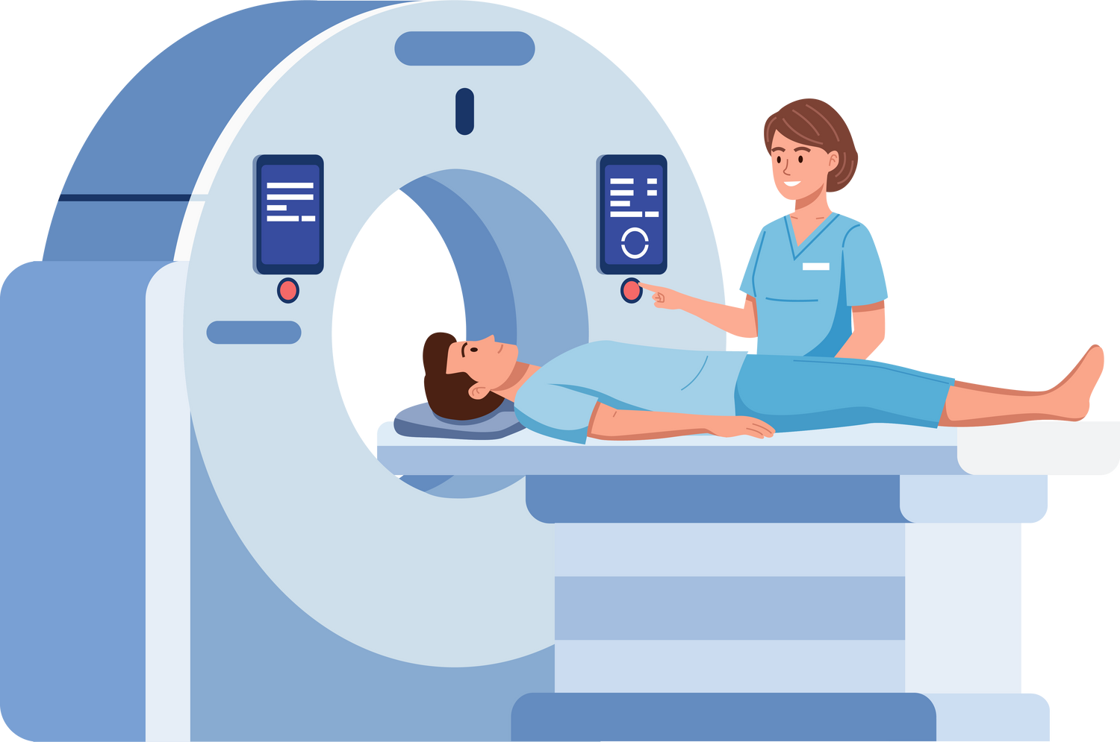
LUNGS ARE FOR LIFE
Ontario Lung Screening Program
Not everyone with lung cancer has symptoms, especially in the early stages.
The Ontario Lung Screening Program uses CT machines to take detailed pictures inside the lungs of people who are at the highest risk of lung cancer from cigarette smoking.
These tests can help catch lung cancer before it spreads. Lung cancer is much more treatable when it's caught early.
Lungs are for Life is copyright of the Canadian Lung Association. Reproduction for educational, non-commercial purposes only.

Slide 16
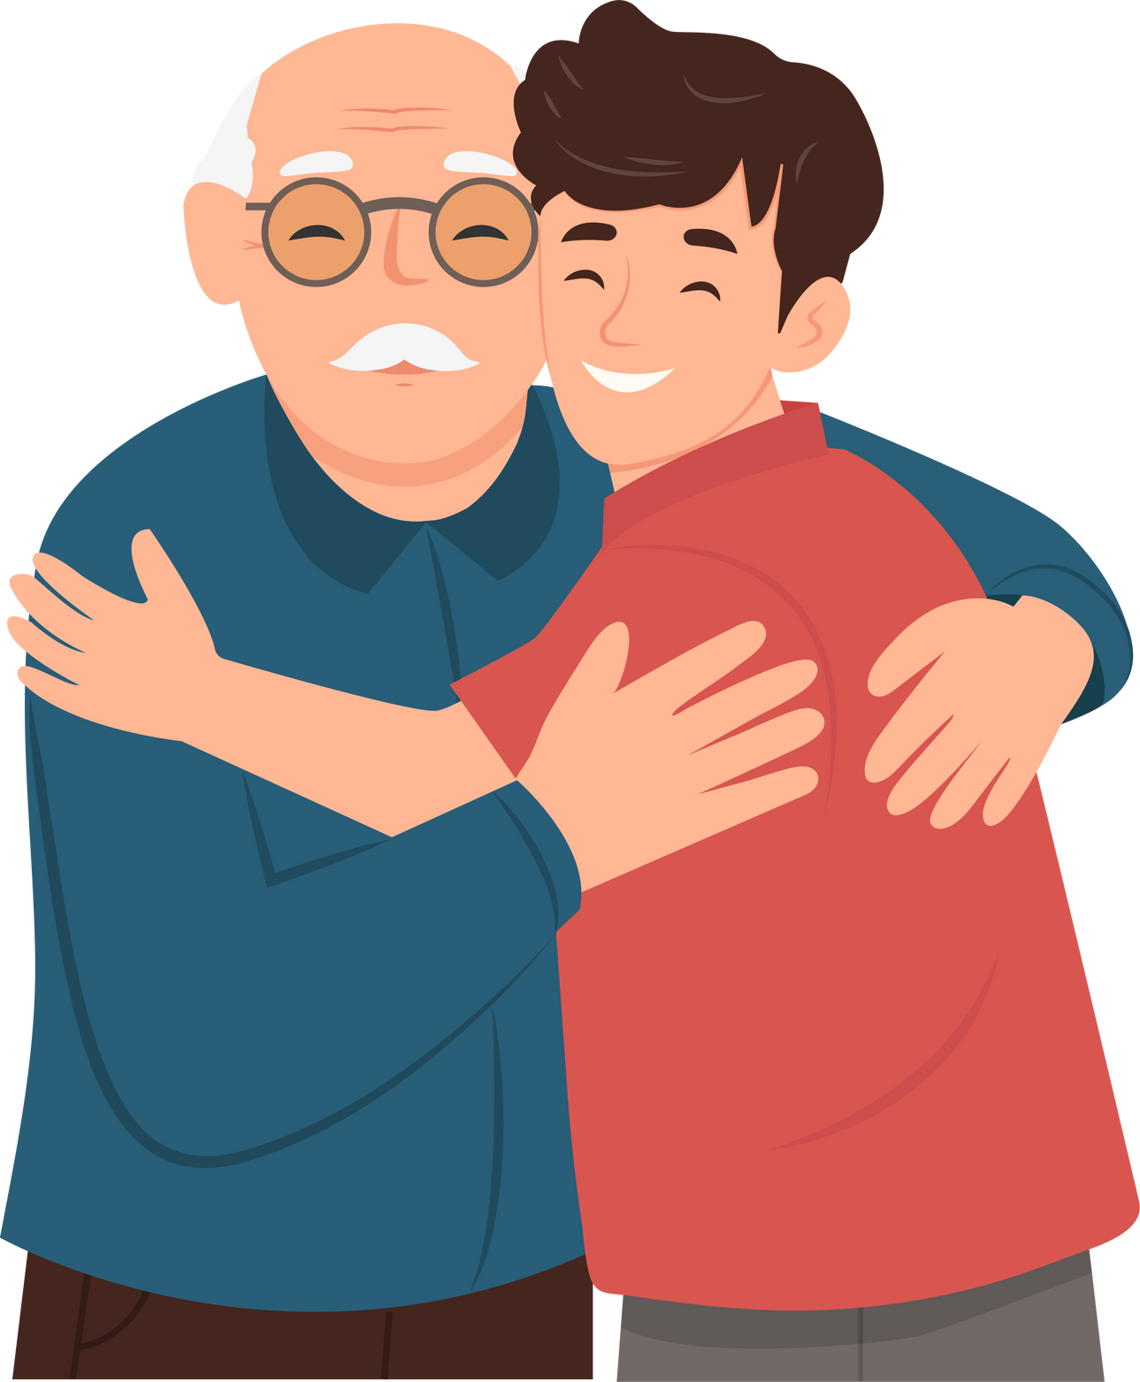
LUNGS ARE FOR LIFE
Ontario Lung Screening Program
If you know someone who:
  Is between 55 and 74 years old
  Smoked for at least 20 years AND
  Still smokes or quit smoking fewer than 15 years ago
you should talk to them about getting screened for lung cancer.
If you think someone you love is at increased risk, consider talking to them about lung cancer. It could save their life!
To learn more about lung cancer risk and screening, visit lung.ca/lung-cancer.
Lungs are for Life is copyright of the Canadian Lung Association. Reproduction for educational, non-commercial purposes only.

Slide 17

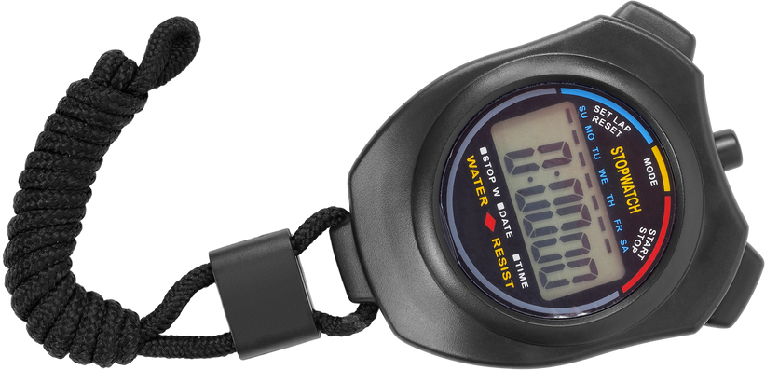
ACTIVITY
Living with COPD: The straw lung challenge
1.
Breathe in and out for 30 seconds.
Put the straw in your mouth and pinch your nose closed.
Breathe in and out through the straw for 30 seconds.
Remove the straw and take deep breaths.
Next, breathing through the straw again, walk in place for 30 seconds.
Take deep breaths to relax.
1 straw
2.
3.
4.
Stopwatch or timer
5.
6.
LUNGS ARE FOR LIFE
Lungs are for Life is copyright of the Canadian Lung Association. Reproduction for educational, non-commercial purposes only.

Slide 18

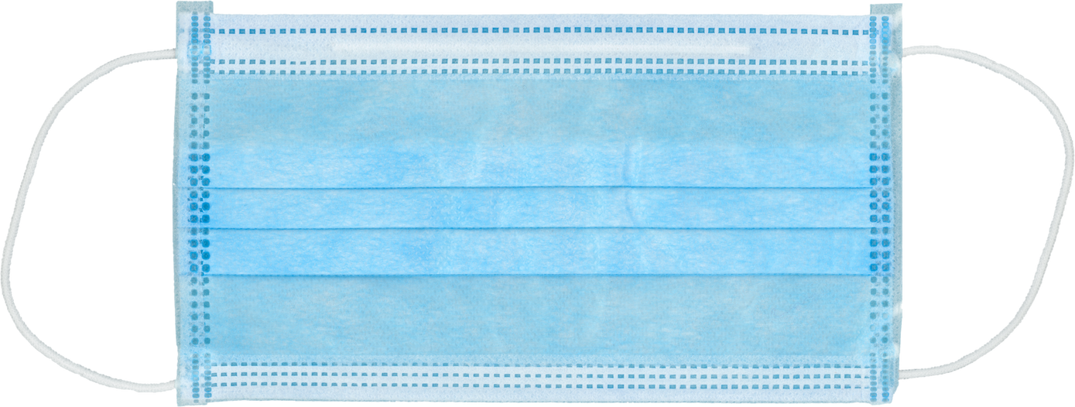
ACTIVITY
Living with COPD: Huffing and puffing
LUNGS ARE FOR LIFE
1.
Put on one of the face masks and hold the piece of paper in front of your face.
Try to move the piece of paper with your breath. Notice how much force is needed.
Put on the second mask over the first.
Again, try moving the paper with your breath.
2.
2 disposable masks
3.
4.
1 sheet of paper
Lungs are for Life is copyright of the Canadian Lung Association. Reproduction for educational, non-commercial purposes only.

Slide 19


ACTIVITY
What would you say?
LUNGS ARE FOR LIFE
What would you say to each person to help reduce the harms of vaping?
I love hanging out with my older brother, but he’s
always vaping.
Now I kind of want to try it.
All my friends vape. When I hang out with them,
I feel left out.
I don’t vape all the time. Only at parties.
Lungs are for Life is copyright of the Canadian Lung Association. Reproduction for educational, non-commercial purposes only.

