Slide 1
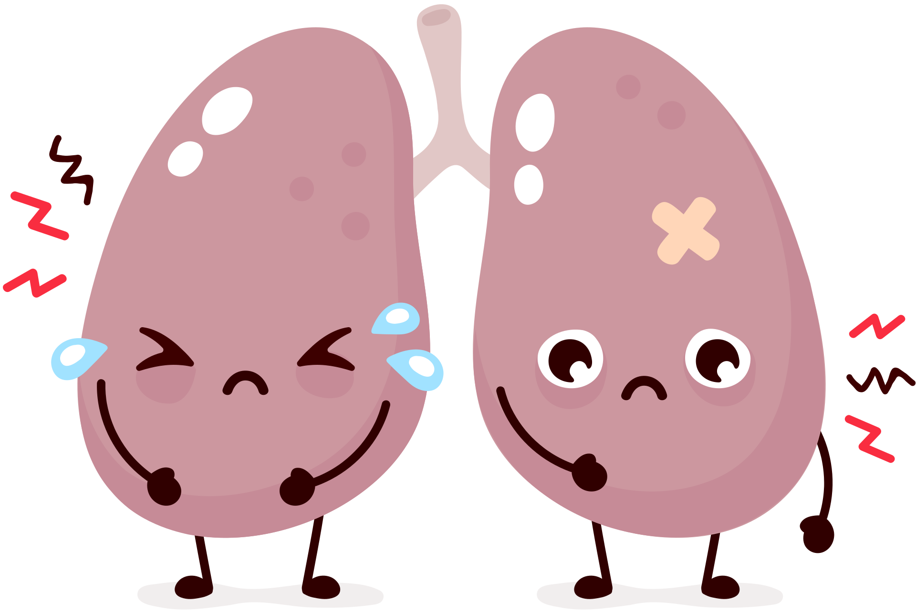

What smoking or vaping can do to your
lungs and respiratory system
Coughing
Sore throat
Breathlessness
Narrower airways
Scarring in the lungs
Less endurance and stamina
Asthma or worsening asthma symptoms
More likely to get sick from infections like a cold or flu
Lungs are for Life is copyright of the Canadian Lung Association. Reproduction for educational, non-commercial purposes only.

Slide 2
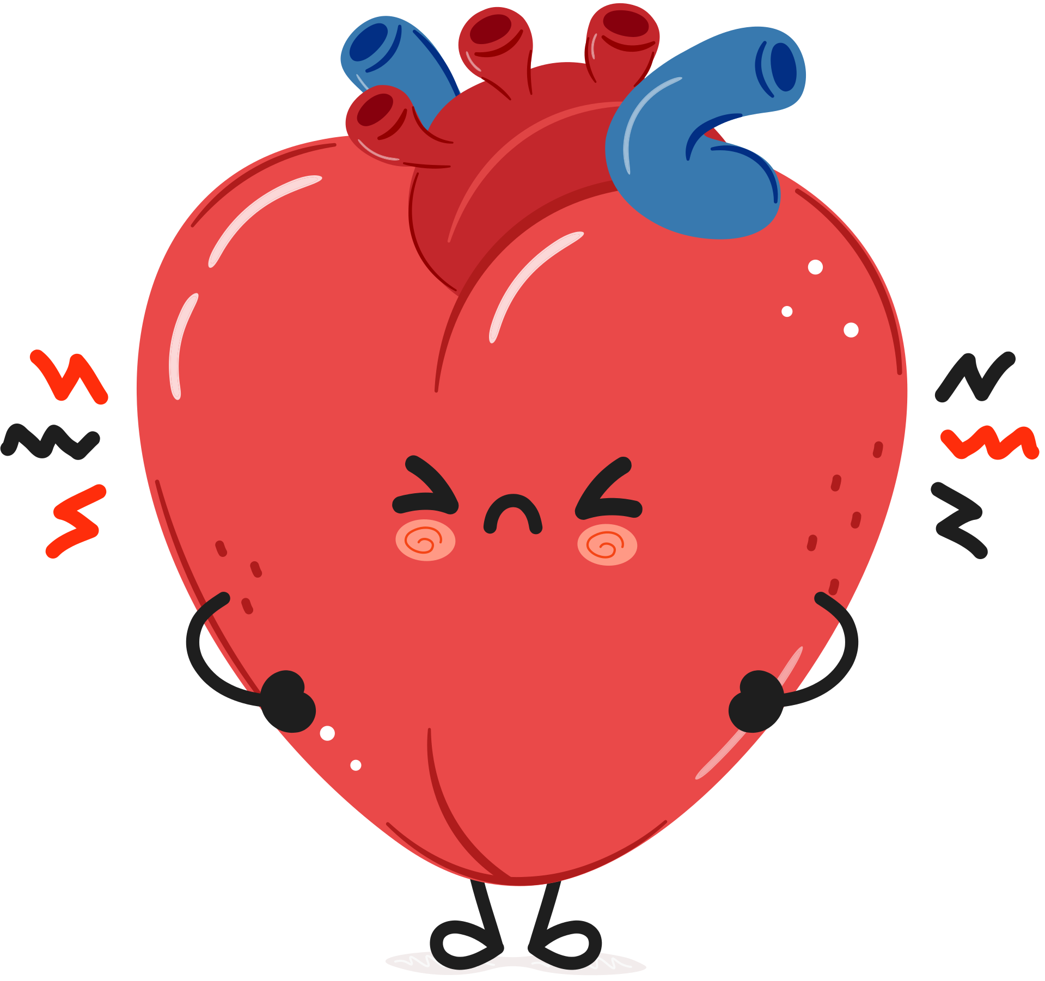
What smoking or vaping can do to your
heart and circulatory system
Increased blood pressure
Damage to blood vessels
Heavy metal build up in blood and organs
Increased risk of heart attack and stroke
Heart arrhythmias (when your heart beats faster than normal or skips beats)
Lungs are for Life is copyright of the Canadian Lung Association. Reproduction for educational, non-commercial purposes only.

Slide 3
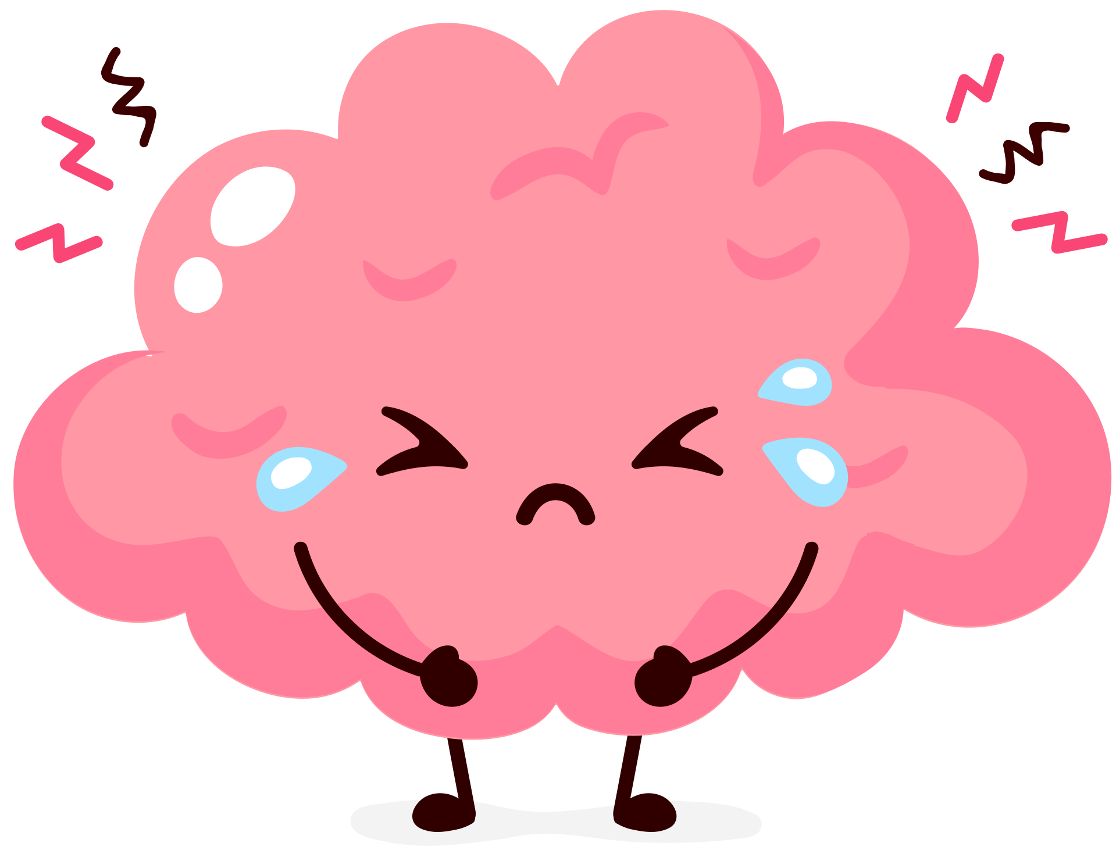
What smoking or vaping can do to your
brain and nervous system
Problems with memory
Problems learning and understanding new information
Problems with impulsivity
Problems planning ahead and following directions
Lungs are for Life is copyright of the Canadian Lung Association. Reproduction for educational, non-commercial purposes only.

Slide 4

What smoking or vaping can do to your
teeth and skin
Tooth decay
Dry mouth
Black, hairy tongue
Gum disease
Clogged pores
Dry, irritated skin
Can make acne worse
Lungs are for Life is copyright of the Canadian Lung Association. Reproduction for educational, non-commercial purposes only.

