Slide 1


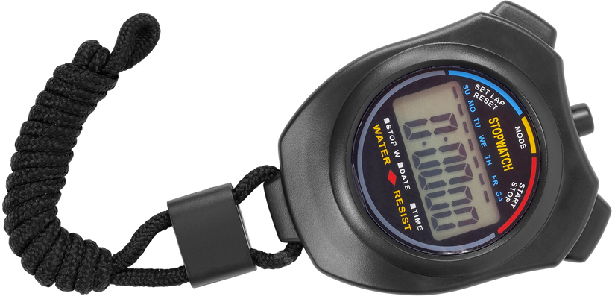
LUNGS ARE FOR LIFE
The straw lung challenge
What is it like to live with COPD?
1 drinking straw
1.
Breathe in and out for 30 seconds.
2.
Put the straw in your mouth and pinch your nose closed.
3.
Breathe in and out through the straw for 30 seconds.
4.
Breathe in and out normally 30 seconds.
stopwatch or timer
5.
Breathing through the straw only, walk in place for 30 seconds.
6.
Take deep breaths to relax.
From the Western University Aging Simulation Lab www.uwo.ca/fhs/agingsim/pdf/Respiratory_System-Straw_Lung_Challenge.pdf Used with permission
Lungs are for Life is copyright of the Canadian Lung Association. Reproduction for educational, non-commercial purposes only.

