Slide 1
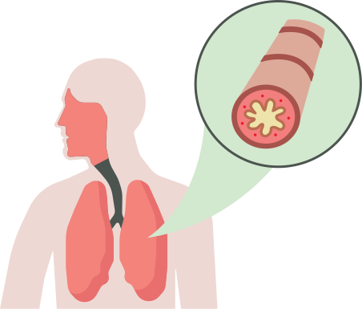

Asthma
Many people with asthma may not experience symptoms until they have a cold, they exercise hard or they're around something that can irritate their lungs (like cigarette smoke or vaping aerosols).
During an “asthma attack”, muscles around the airways get tighter and the airways swell and fill with mucous. This makes it harder to breathe.
An asthma attack can be fatal, especially in people with severe asthma.
Lungs are for Life is copyright of the Canadian Lung Association. Reproduction for educational, non-commercial purposes only.

Slide 2
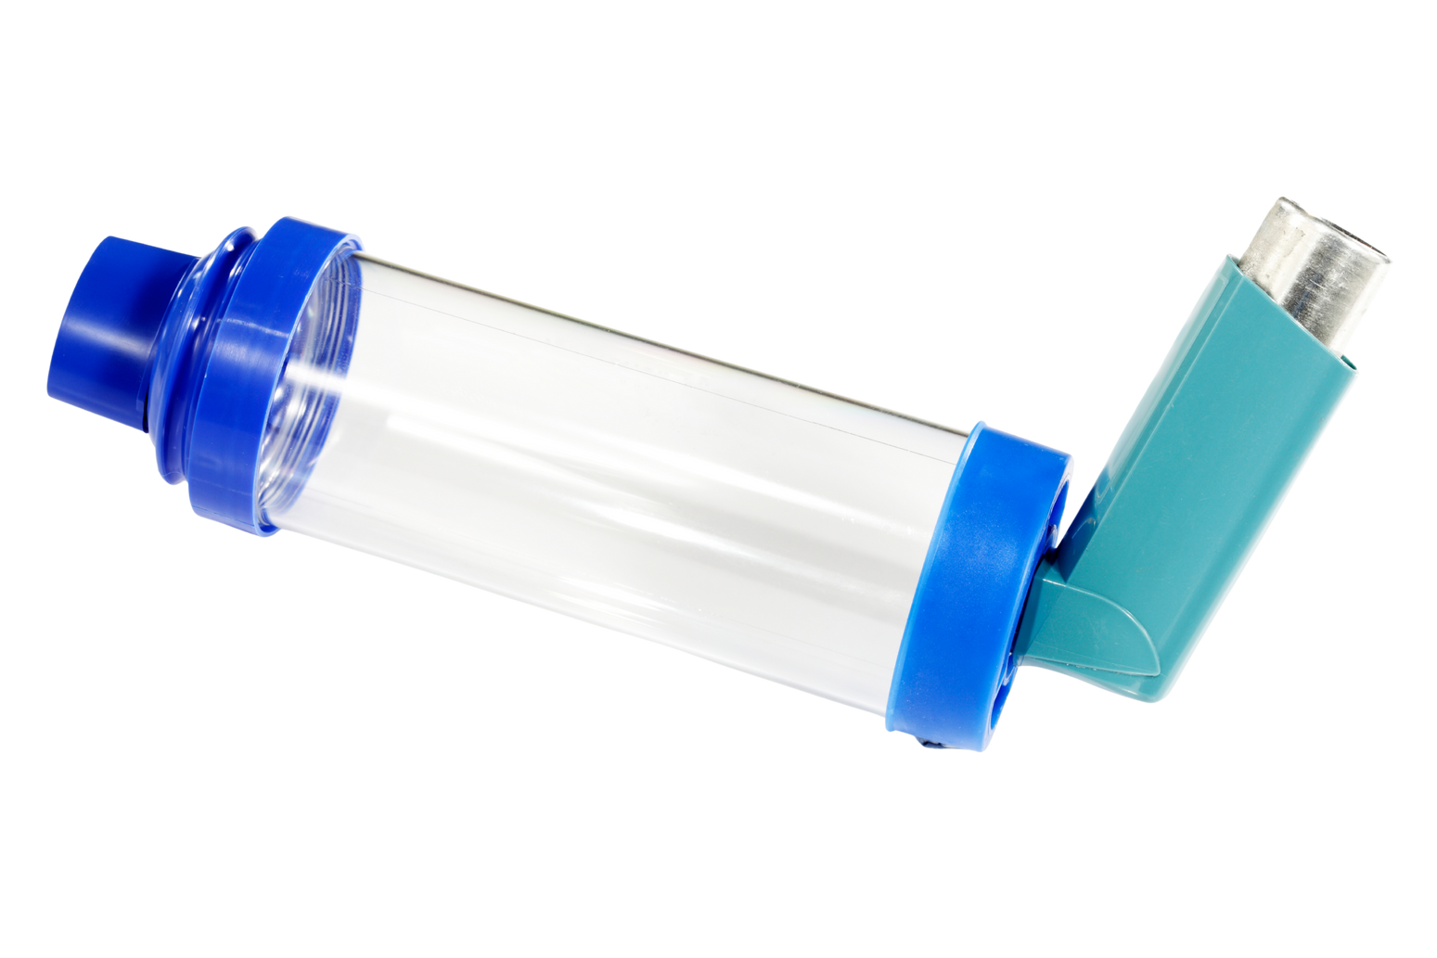
Asthma
puffer
There is no cure for asthma but it can be treated with medication (like inhalers or “puffers”).
If you have asthma, it’s important to take your medication exactly as prescribed by your doctor, even if you’re breathing well.
It is recommended that you use your puffer with a spacer. Using a spacer is more efficient as more medicine enters your lungs, rather than your mouth, throat or stomach.
spacer
Lungs are for Life is copyright of the Canadian Lung Association. Reproduction for educational, non-commercial purposes only.

Slide 3
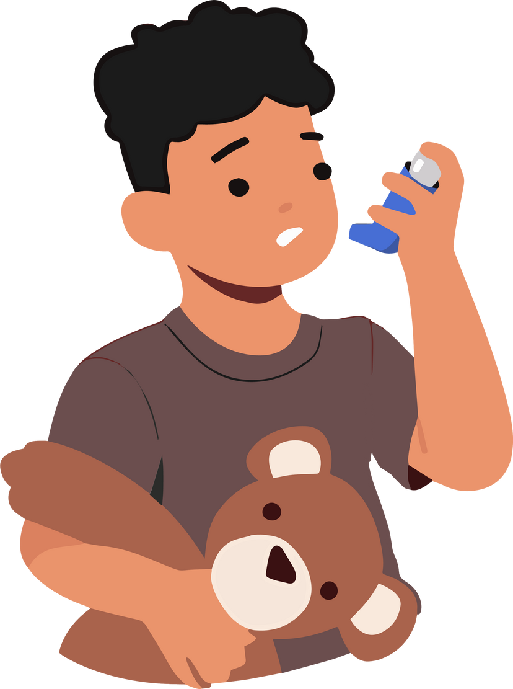
What do smoking and vaping have to do with asthma?
  Asthma is more common in children who grow up around people who smoke.
  People who smoke or vape can experience asthma-like symptoms.
  If you have asthma, smoking and vaping can make the symptoms worse.
  Being near someone who’s smoking or vaping can trigger an asthma attack.

