Slide 1



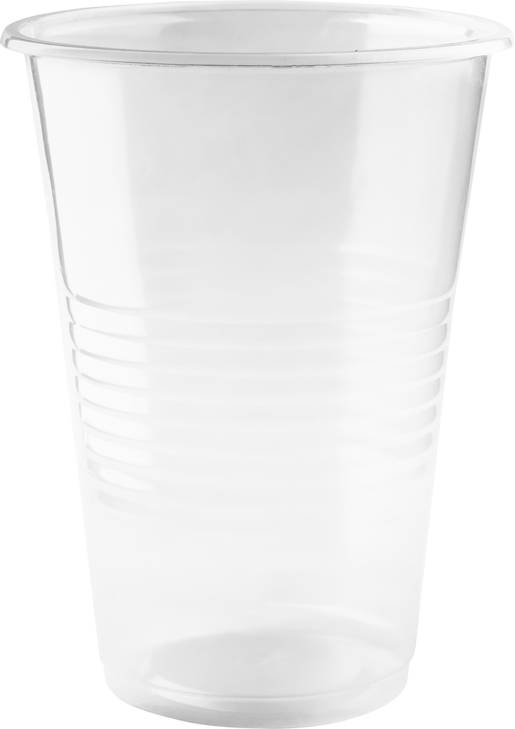
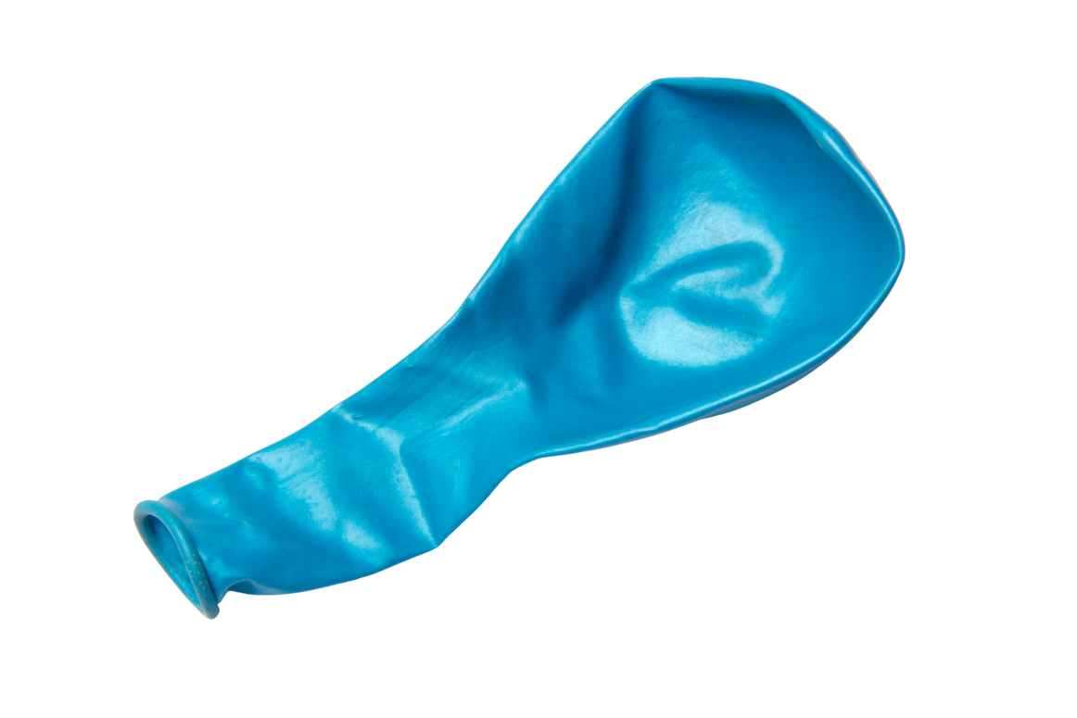
LUNGS ARE FOR LIFE
Build a model of your lungs
2 drinking straws
the bronchi
2 small balloons
the lungs
1 clear plastic cup
the body
Tools
Black marker
Tape
Scissors
Rubber bands
1 large balloon
the diaphragm
Lungs are for Life is copyright of the Canadian Lung Association. Reproduction for educational, non-commercial purposes only.

Slide 2
LUNGS ARE FOR LIFE
Build a model of your lungs
Turn the cup upside down and use the marker to draw a small rectangle (about 2cm x 1cm) in the center of the bottom of the cup. Use the scissors to cut out the rectangle.
Take the two straws and cut off about one-third of their length. Keep the shorter section of each straw.
cut
cut
Lungs are for Life is copyright of the Canadian Lung Association. Reproduction for educational, non-commercial purposes only.

Slide 3

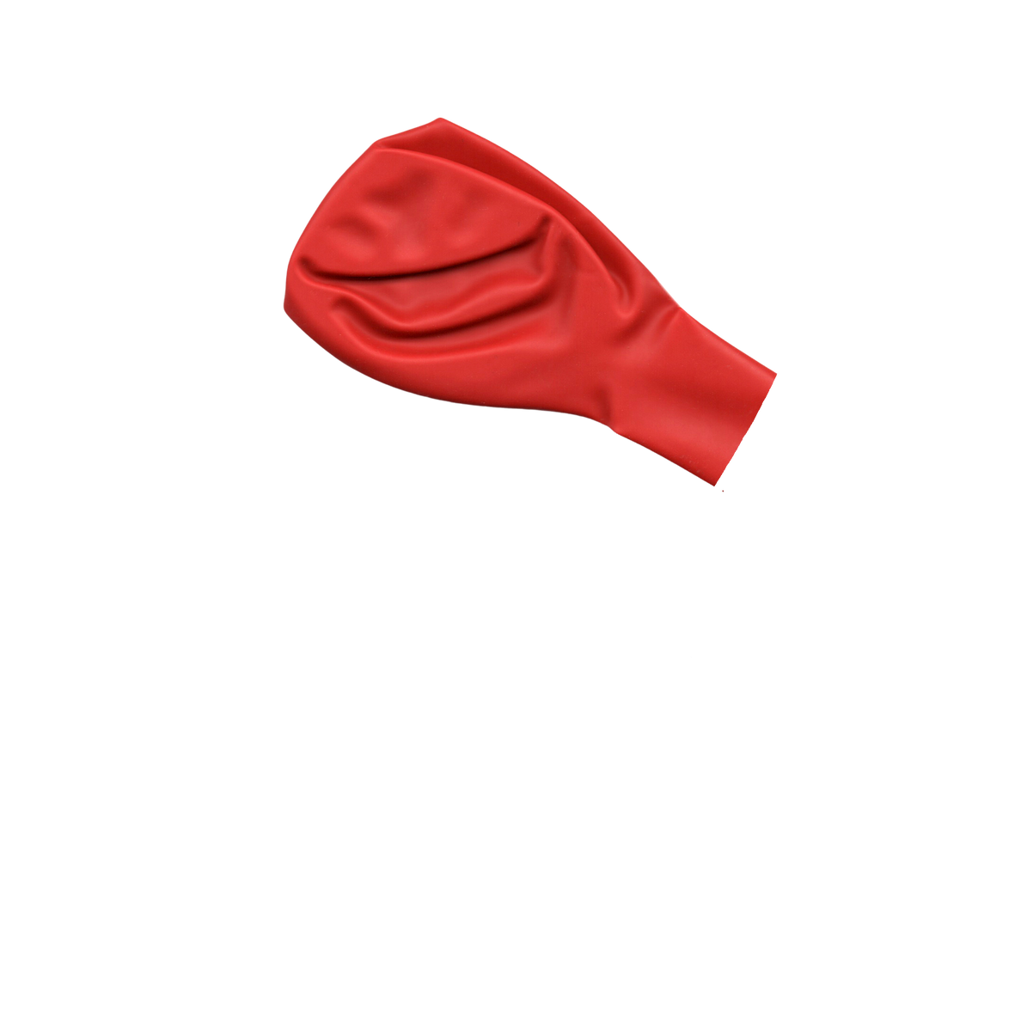
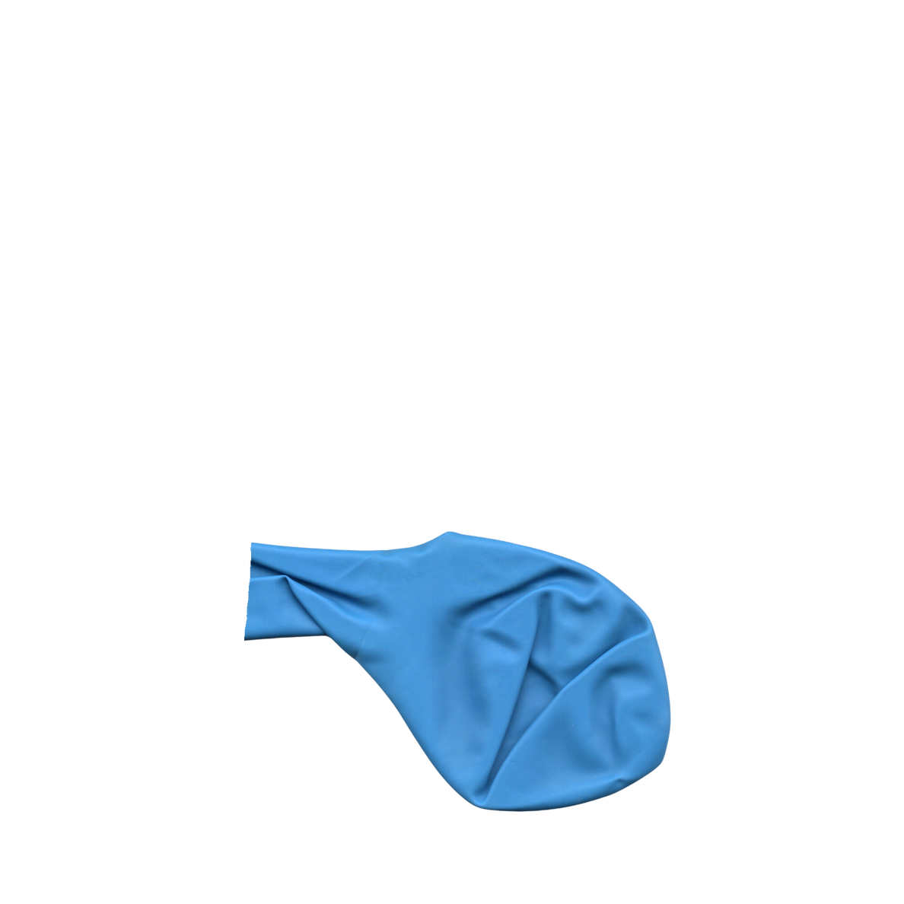
LUNGS ARE FOR LIFE
Model lungs
tape
Cut off half of the length of the “stem” of each small balloon.
Insert the end of each straw into a small balloon. Tape it securely to seal it.
Align the straws side-by-side and tape the other ends of the straws together.
insert and tape
Lungs are for Life is copyright of the Canadian Lung Association. Reproduction for educational, non-commercial purposes only.

Slide 4
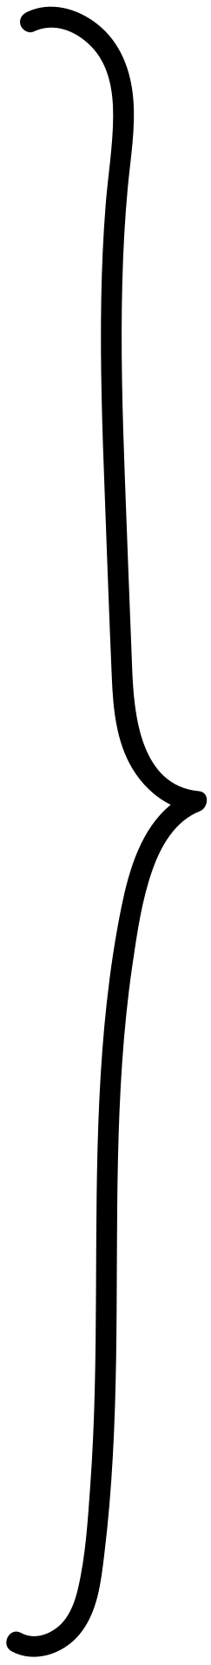

LUNGS ARE FOR LIFE
Model lungs
Turn the cup upside down. Insert the taped end of the straws into the mouth of the cup and through the hole you cut. The two small balloons will be inside the cup and the taped ends of the straws will be poking out the hole.
Tie a knot in the large balloon. Cut the balloon at its widest part and keep the part with the knot.
knot
keep
cut
Lungs are for Life is copyright of the Canadian Lung Association. Reproduction for educational, non-commercial purposes only.

Slide 5
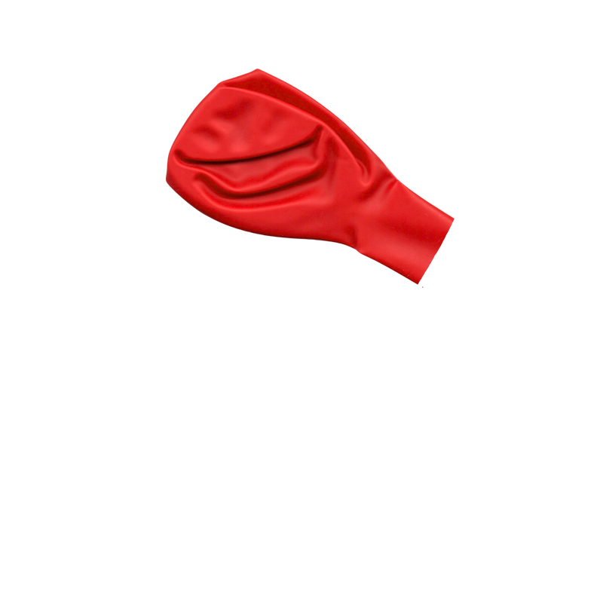
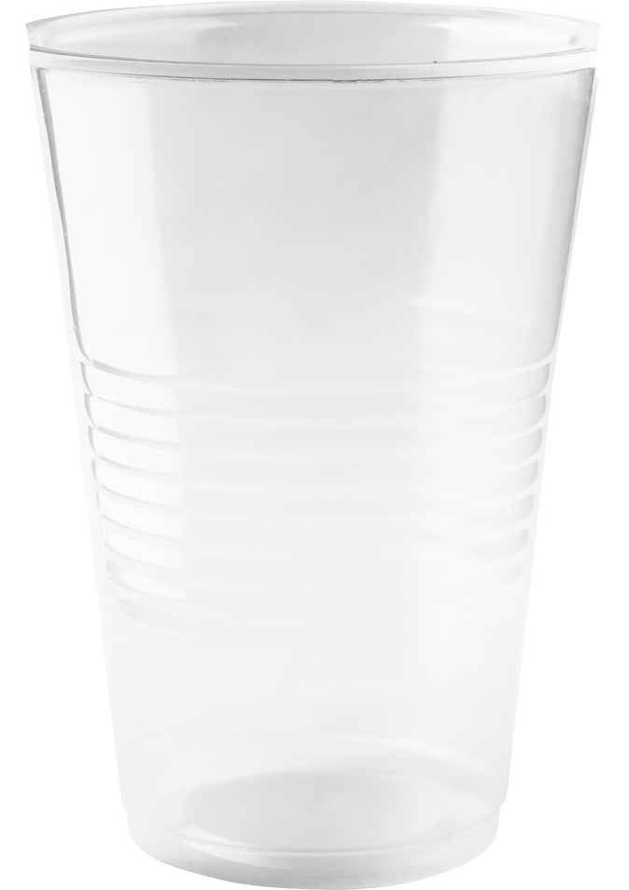

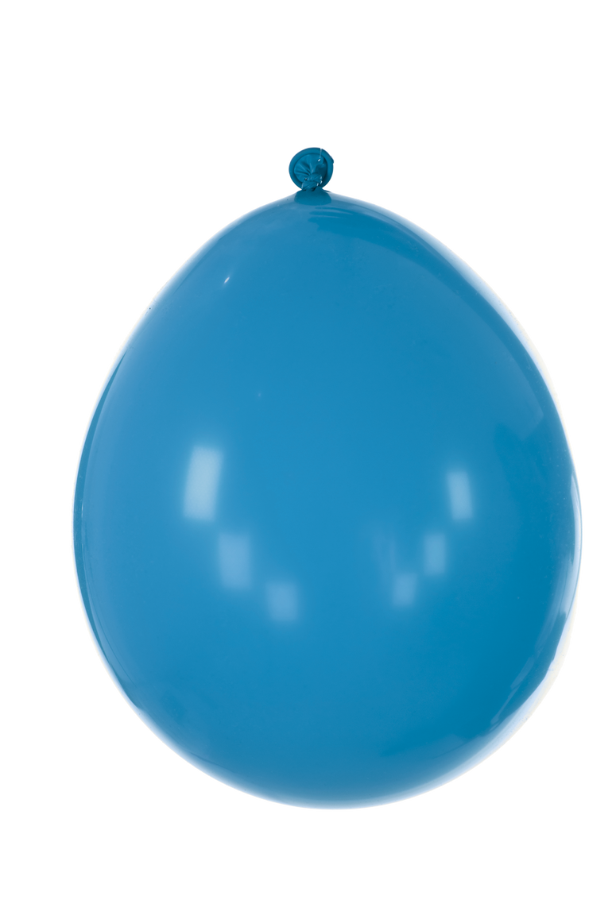
LUNGS ARE FOR LIFE
Model lungs
Stretch the large balloon over the mouth of the cup, making a lid. It should fit snugly. If needed, secure the balloon with rubber bands or tape to keep it in place.
Check for any gaps where the large balloon meets the cup and where the straws exit the cup.
Holding the cup upside down, gently pull on the knot on the large balloon.
Watch the small balloons inflate, just like lungs filling with air!
no gaps
no gaps
pull
Lungs are for Life is copyright of the Canadian Lung Association. Reproduction for educational, non-commercial purposes only.

