Slide 1
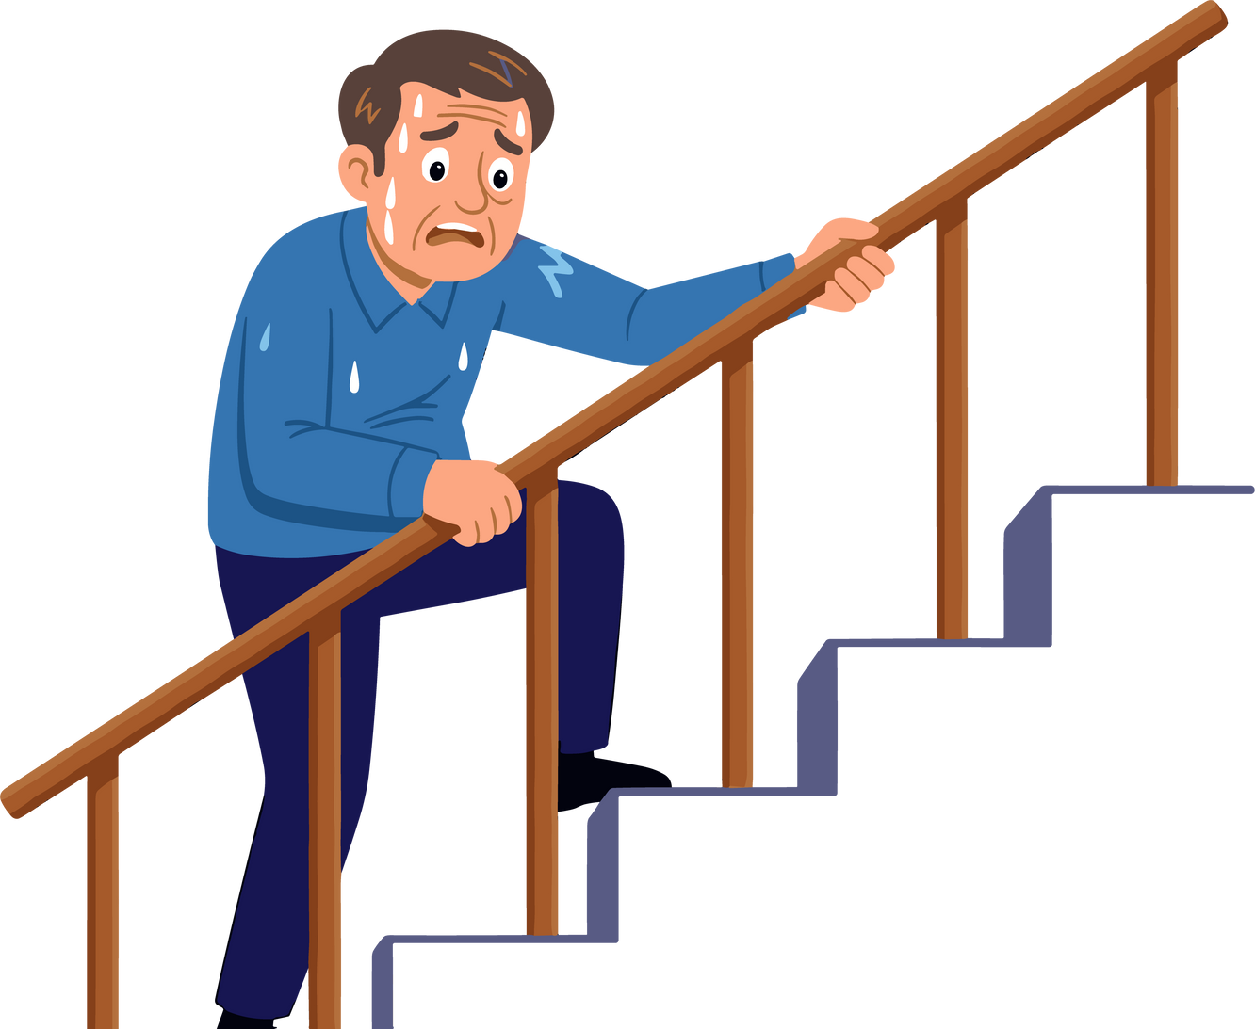

Chronic obstructive pulmonary disorder (COPD)
  Includes emphysema and chronic bronchitis
  Makes breathing very difficult
  Causes the airways become swollen and fill with mucus
  Air sacs (alveoli) also break down, trapping air in the lungs
  About 70% of people with COPD have a history of smoking
Someone with COPD may not realize that they are becoming more short of breath until it becomes very hard to do simple tasks like walking up stairs. Sometimes people think being short of breath is just “getting old”.
Lungs are for Life is copyright of the Canadian Lung Association. Reproduction for educational, non-commercial purposes only.

Slide 2
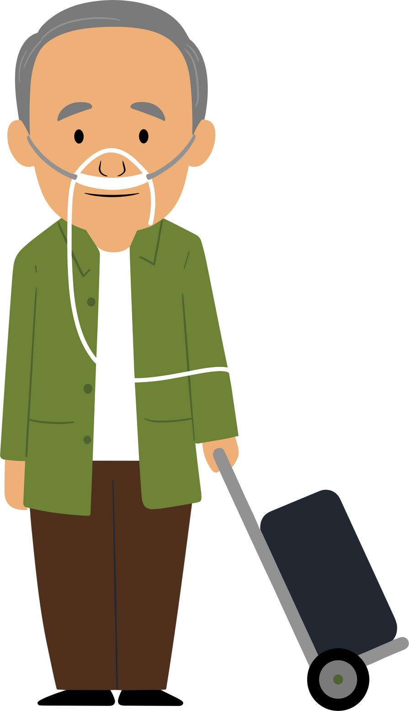
Chronic obstructive pulmonary disorder (COPD)
Some people with COPD need to use oxygen tanks to get enough oxygen into their blood because their lungs are so damaged.
There is no cure for COPD. It can be treated with inhalers and other medicine but it will get worse over time and can be fatal.
Exercising and staying active can slow down COPD.
Lungs are for Life is copyright of the Canadian Lung Association. Reproduction for educational, non-commercial purposes only.

