Slide 1

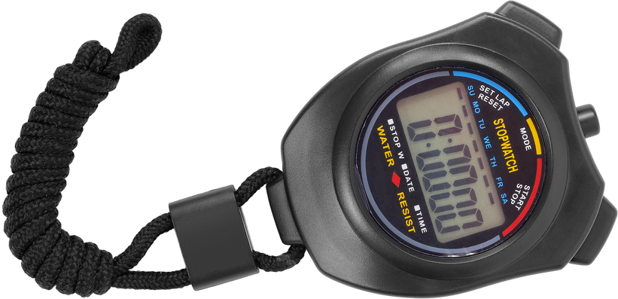

Living with COPD: The straw lung challenge
1.
Breathe in and out for 30 seconds.
Put the straw in your mouth and pinch your nose closed.
Breathe in and out through the straw for 30 seconds.
Remove the straw and take deep breaths.
Next, breathing through the straw again, walk in place for 30 seconds.
Take deep breaths to relax.
1 straw
2.
3.
4.
Stopwatch or timer
5.
6.
Lungs are for Life is copyright of the Canadian Lung Association. Reproduction for educational, non-commercial purposes only.

