Slide 1

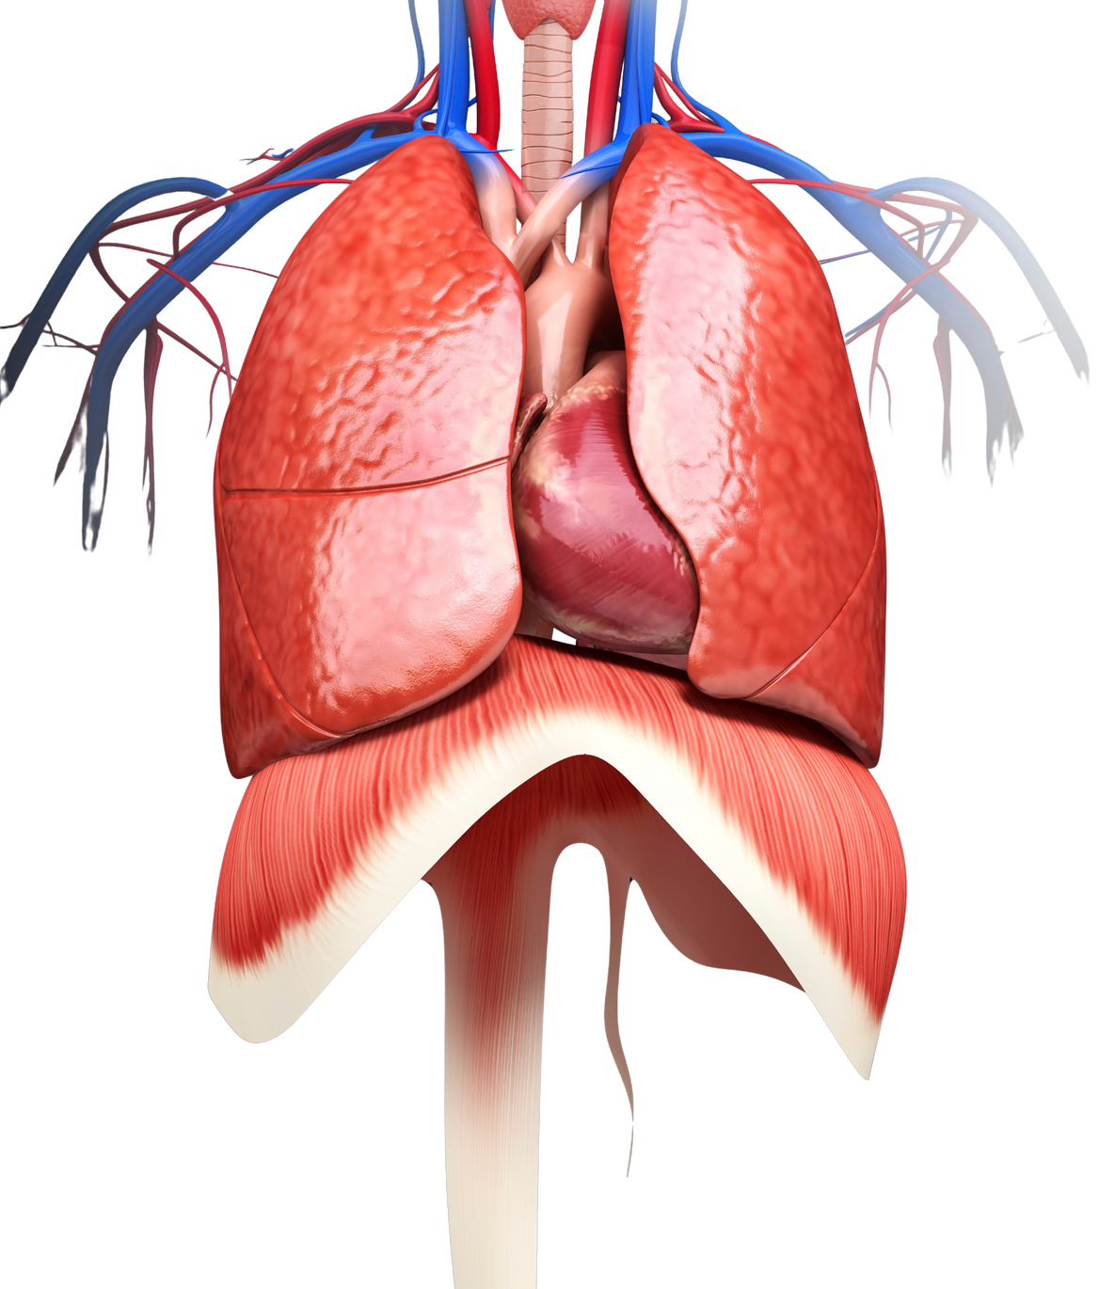
LUNGS ARE FOR LIFE
Your lungs
You have two lungs. Together, they form one of the largest organs in your body.
The lung on the left is a bit smaller than the lung on the right to leave room for your heart. The lungs and heart work together when you breathe.
Below your lungs is the diaphragm. Your diaphragm is a large muscle that works with your lungs to get air into your body (inhale) and out (exhale).
Left lung
Right lung
Heart
Diaphragm
Lungs are for Life is copyright of the Canadian Lung Association. Reproduction for educational, non-commercial purposes only.

Slide 2
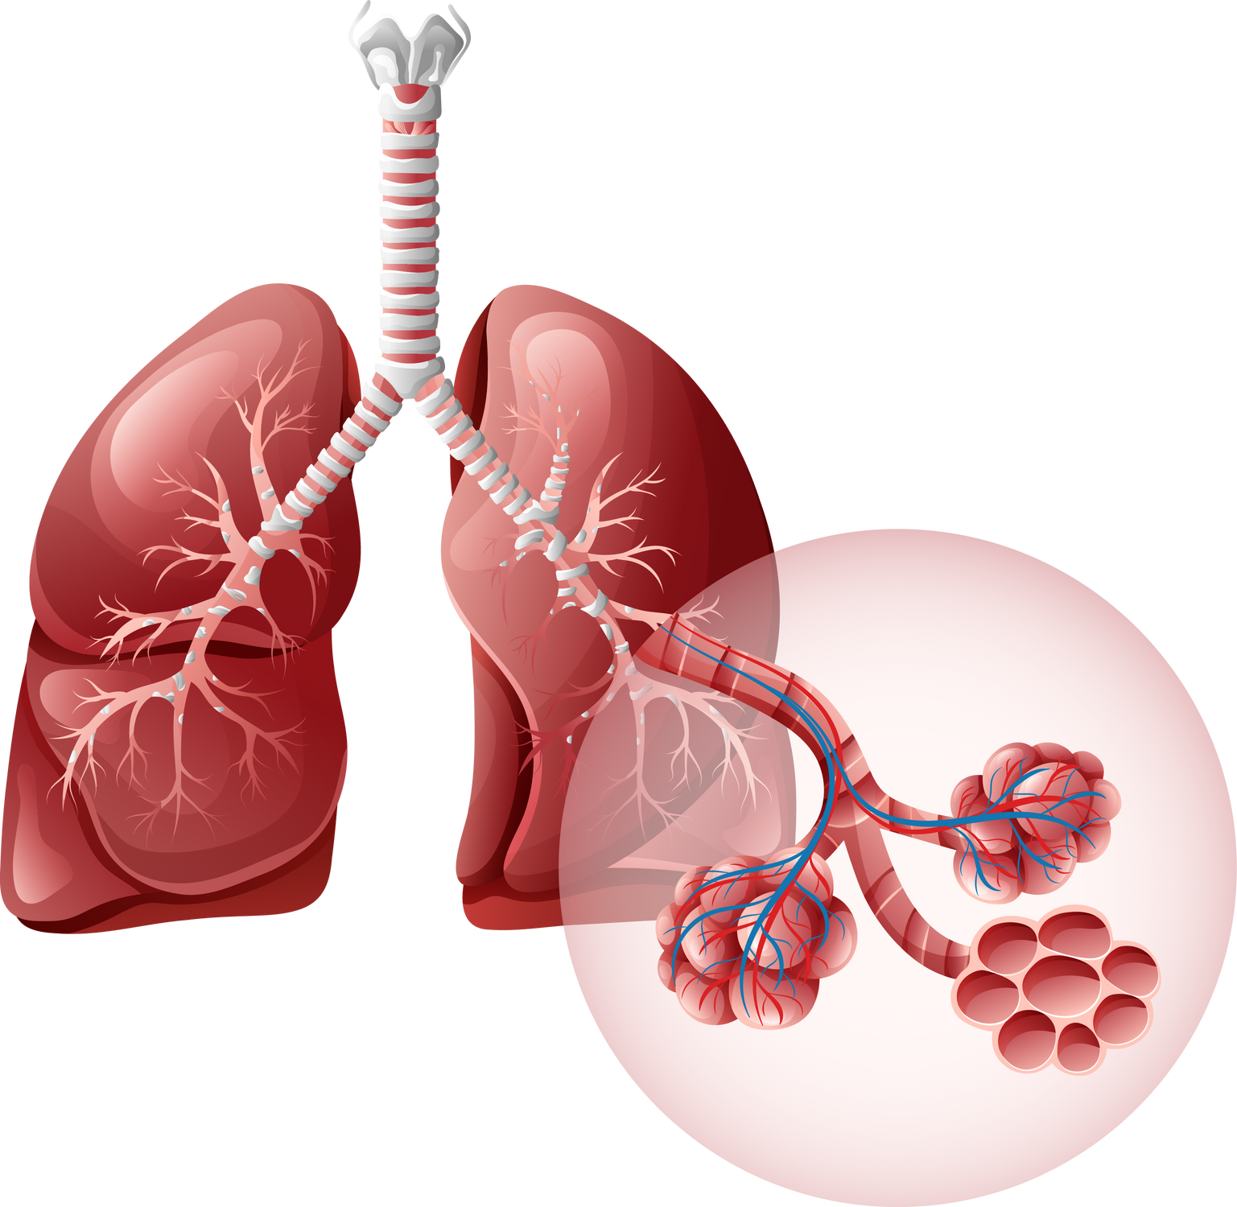
LUNGS ARE FOR LIFE
Inside your lungs
Bronchi
Trachea (windpipe)
Alveoli
Bronchioles
Lungs are for Life is copyright of the Canadian Lung Association. Reproduction for educational, non-commercial purposes only.

Slide 3
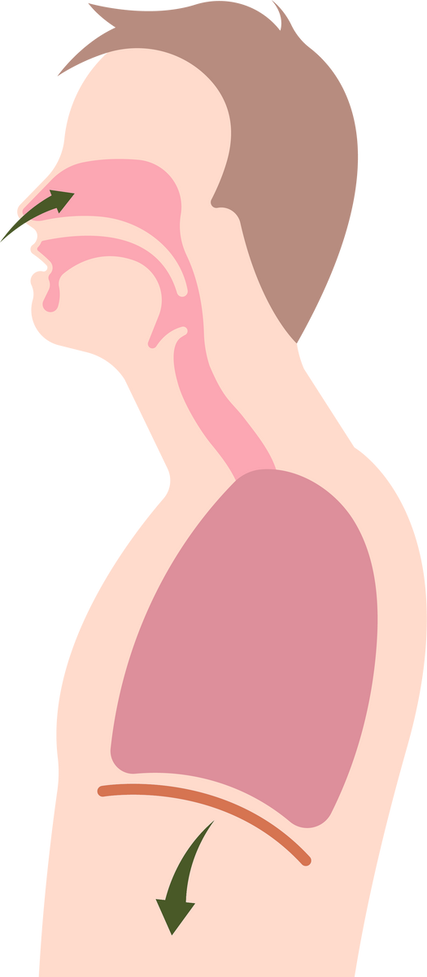
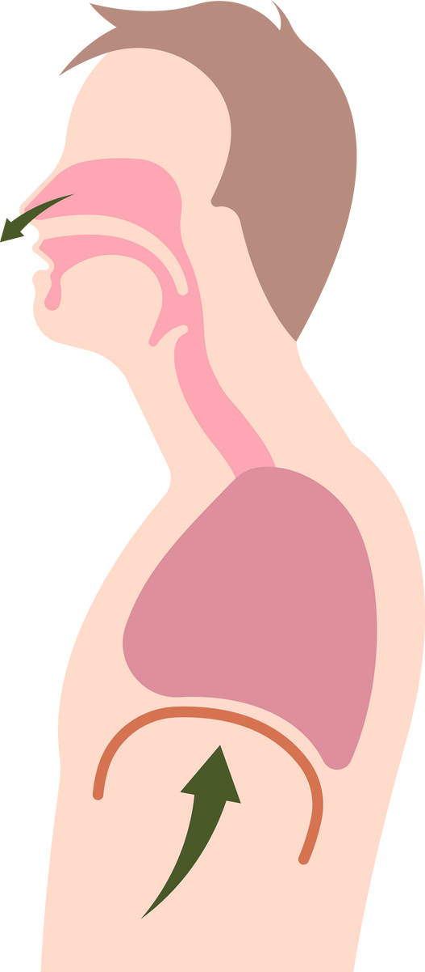


LUNGS ARE FOR LIFE
How does breathing work?
Breathing is how your body gets the oxygen it needs from the air. It’s also how your body gets rid of the carbon dioxide it doesn’t need.
air is drawn into the lungs
air is pushed out of the lungs
diaphragm contracts
and flattens out
diaphragm relaxes
Lungs are for Life is copyright of the Canadian Lung Association. Reproduction for educational, non-commercial purposes only.

Slide 4
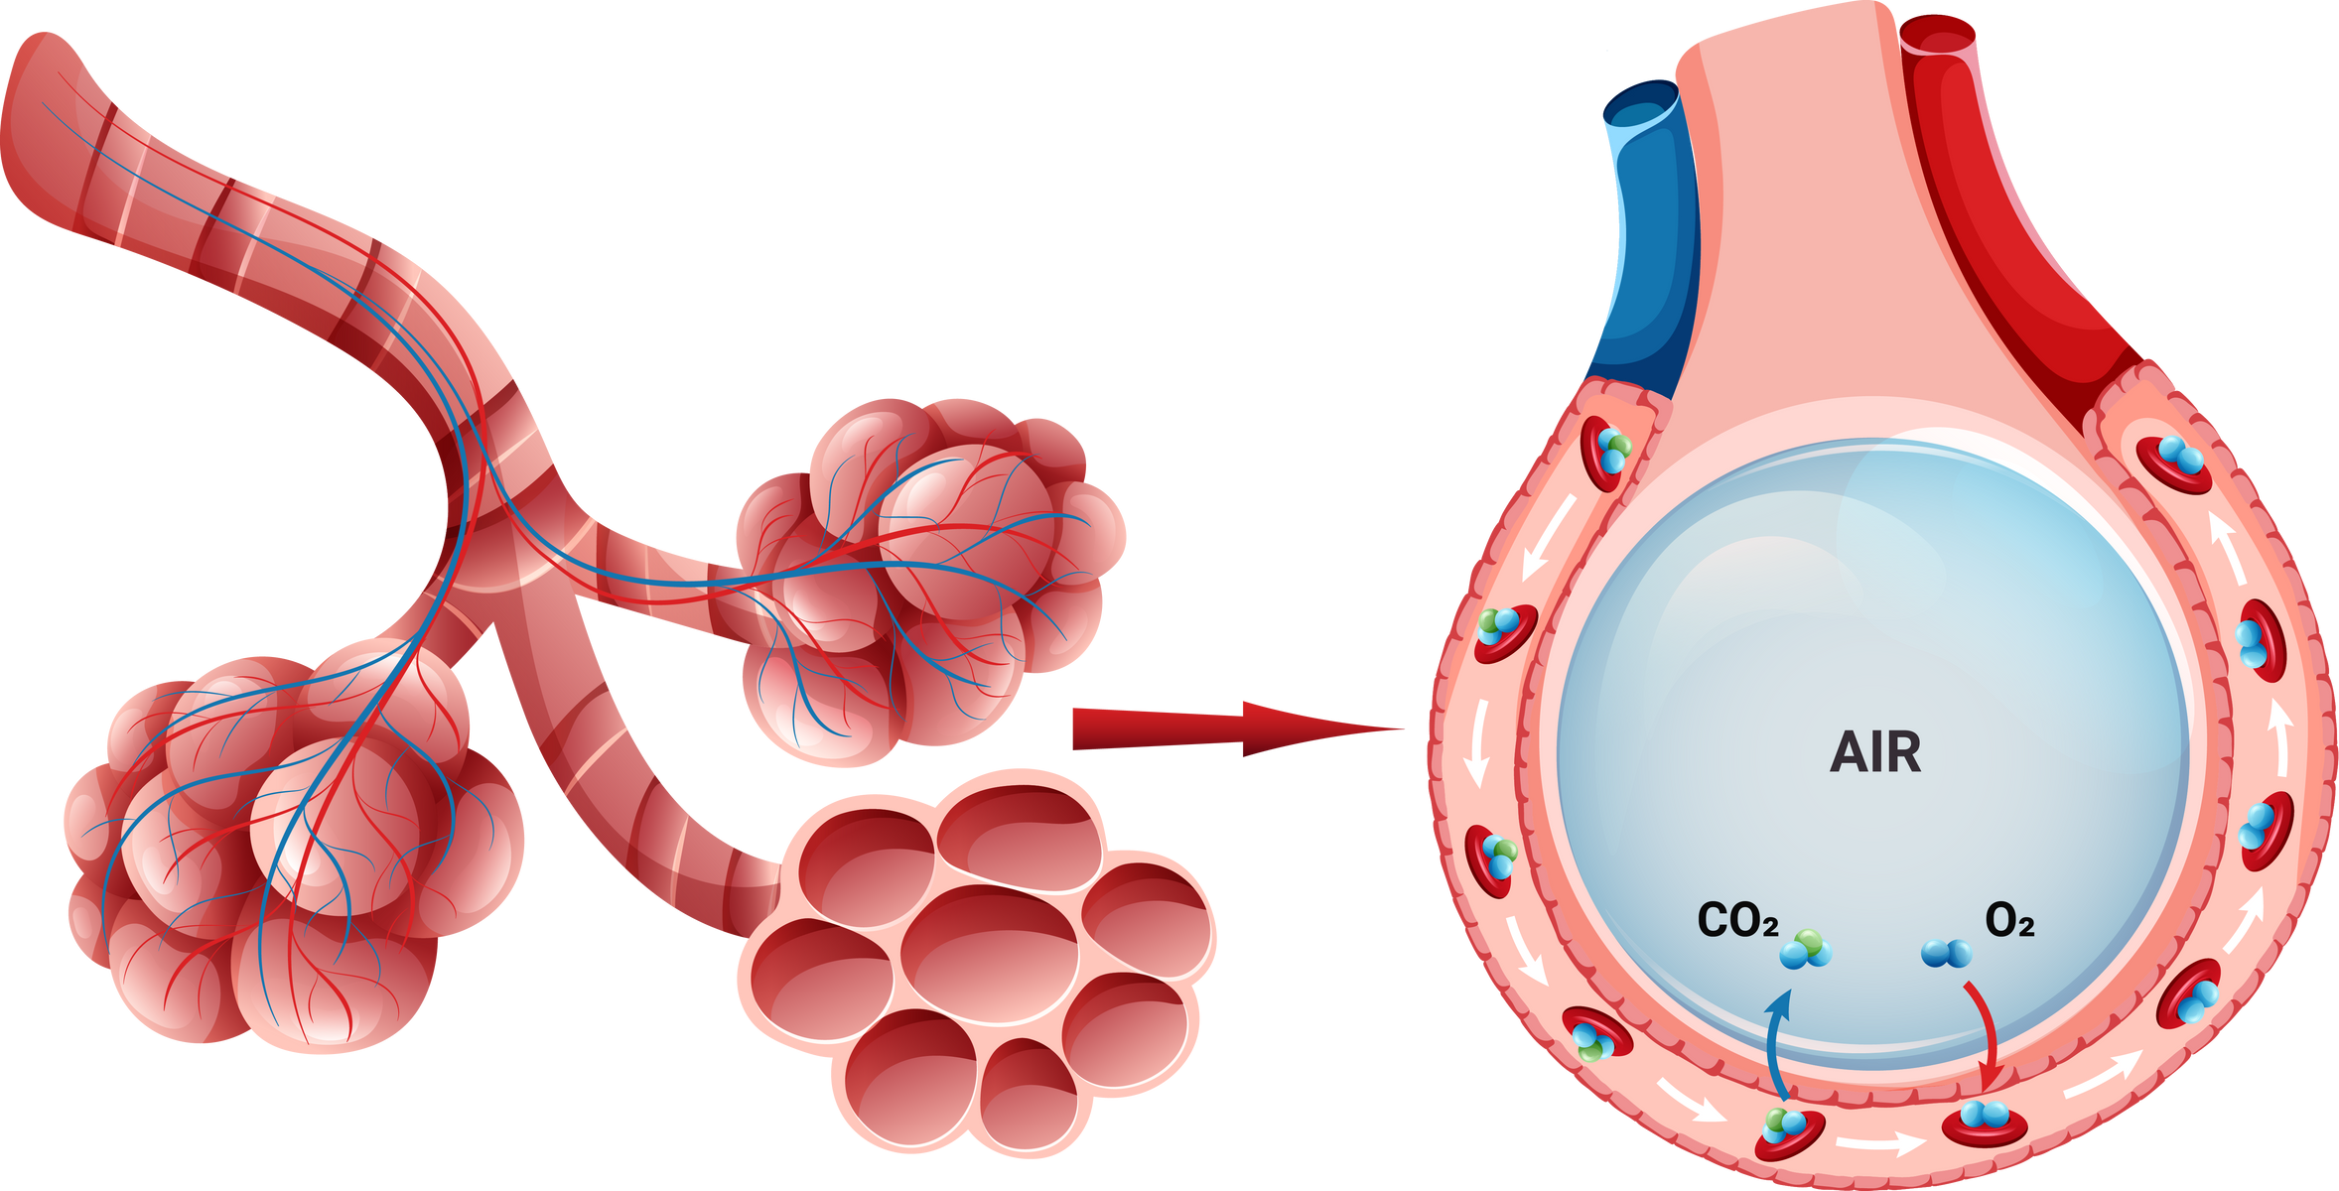
LUNGS ARE FOR LIFE
Gas exchange
When you inhale, air enters deep into the lungs and reaches the alveoli at the end of the bronchioles.
The oxygen in the air goes through the walls of the air sacs, into the capillaries, and into your bloodstream. The heart pumps the blood with the new oxygen to all parts of the body.
Carbon dioxide, which your body needs to get rid of, leaves the capillaries and enters into the alveoli. When you exhale, you breathe out the carbon dioxide.
Lungs are for Life is copyright of the Canadian Lung Association. Reproduction for educational, non-commercial purposes only.

Slide 5
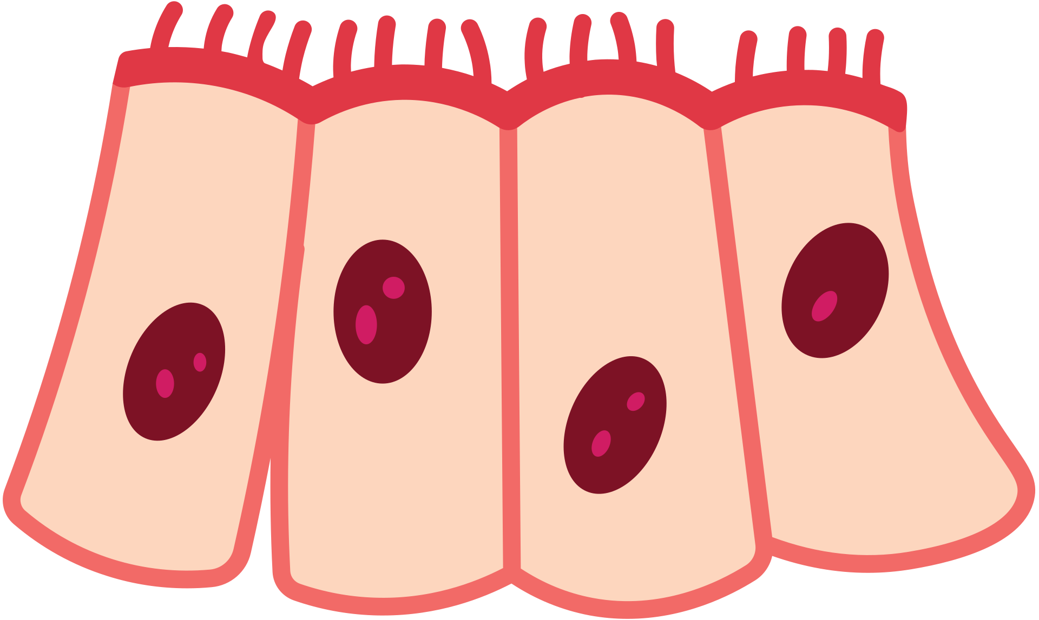
LUNGS ARE FOR LIFE
How your body protects your lungs
cilia
You breathe in dirt and dust every day. The mucus in your airway acts like a sticky trap for this dust and dirt.
Once it’s “trapped”, your body gets rid of this mucus using little hairs called cilia that line the inside of your nose and throat. The hairs beat back and forth in waves to move the mucus like a conveyor belt up the airway so you can cough it up and out of your body.
Lungs are for Life is copyright of the Canadian Lung Association. Reproduction for educational, non-commercial purposes only.

Slide 6






LUNGS ARE FOR LIFE
How you can protect your lungs
Don’t vape or smoke.
Stay away from people who are smoking or vaping so you don’t breathe in their smoke or vape emissions.
Stay away from chemicals that can irritate your lungs.
Make sure doors and windows are open if you're using cleaners, especially ones that contain harsh chemicals.
Limit your use of aerosols (spray cans), like hair spray or air fresheners.
Get plenty of exercise and eat nutritious food.
Stay away from fires, including camp fires.
If there smoke in the air outside from nearby forest fires, don't spend a lot of time outside.
Lungs are for Life is copyright of the Canadian Lung Association. Reproduction for educational, non-commercial purposes only.

Slide 7


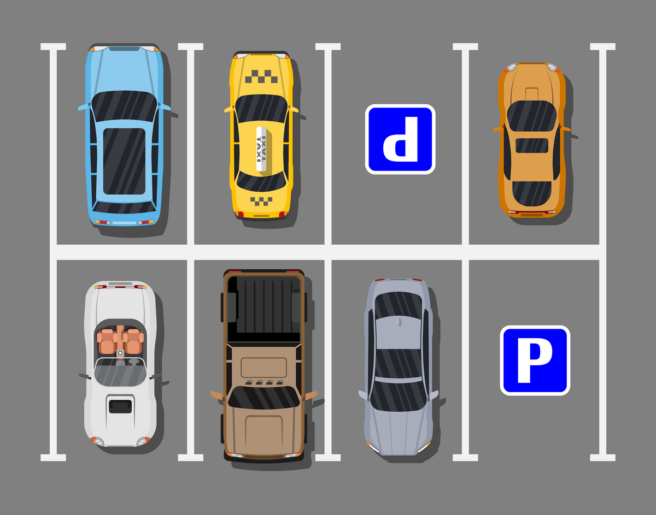
LUNGS ARE FOR LIFE
Did you know?
The total surface area of lungs is about 70 to 100 m2. This is about the same size as:
  half a tennis court
  6 to 8 parking spaces
  1 classroom
An adult’s lungs contain approximately 2,400 kms of airways. Stretched out, the airways of three adults could reach from one end of Canada to the other.
An adult has on average 480 million alveoli in their lungs. In one tiny mm3 (about the size of a drop of water), there are about 170 alveoli.
LUNGS ARE FOR LIFE
Lungs are for Life is copyright of the Canadian Lung Association. Reproduction for educational, non-commercial purposes only.

